Slide 1
Understanding Photographs:
Introduction to Archival
Principles and Practices
Cushing Memorial Library & Archives
Texas A&M University

Slide 2
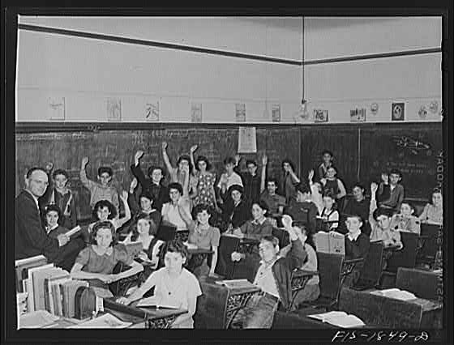
Questions and Comments
Notes:
Classroom in a grade school of San Leandro, California. All children with their hands raised are of Portuguese descent, and are proud of it, 1942 Apr., Russell Lee, FSA-OWI, LC P&P, fsa8d04058.
Tour Comments
WAVR: Scoring
Issues:
As much about repository ID and needs as about the offer
Negs as asset (true master) or liability ($$$) dep on artifactual value. value of preserving negs/color in increasingly digital world; concern about digital copy overtaking original
Rights never clearcut
Lack of staff expertise
WAVR Events: Retention schedule-intent not to dump on state archives but to increase cooperation and partnership (or idea of it) bet. similar repositories; mission not always in step with reality. Low legal risk since already part of holdings. Privacy issues with some visitors/volunteers but negligible. Grip and grin or mastery? WAVR already has some rights. What is gained by keeping negs at WAVR?
PORTRAIT: No permission statements. Legal risk if not dead. Rodents not huge threat. Static/posed photos. Interpretation of names in logbook could be problematic, logbook as valuable to genealogy.
MORGUE: Photos with publication as intent. Active BIOG and SUBJ. microfilm of newspaper available. Wire service as exception. Associational value higher since newspaper is in archive. More bang for buck w/biog than port.

Slide 3
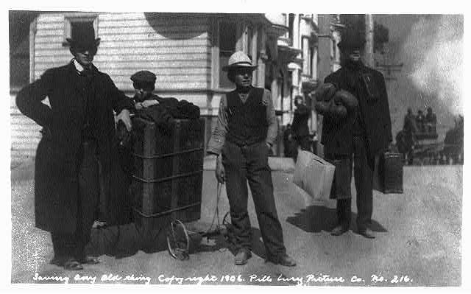
Module 5: Accessioning and Arrangement
Notes:
Saving any old thing, LOT 5253, LC-USZ62-62973 (b&w film copy neg.), Prints and Photographs Division, Library of Congress, c1906 by Pillsbury Picture Co. San Francisco Earthquake
Think about what accessioning and arrangement of photos has in common with accessioning and arrangement of textual materials? How do they differ? Biggest difference is numbering and preservation (similar elements otherwise). How many have anything at all to do with the accessioning process?
SAA Glossary:
n. Materials physically and legally transferred to a repository as a unit at a single time; an acquisition. v. 1. To take legal and physical custody…and to formally document their receipt. 2. To document the transfer of records or materials in…the repository’s holdings.
Accessioning photographs is not radically different than accessioning other collection material, biggest difference is numbering.
Activities slide deleted:
Accessioning Arrangement
Create record & files Plan for processing
Examine material Initial sort & organize
Number & log Label & house
Check housing Dispose
Mark and store Preliminary description
During both accessioning and arrangement activities, regular review of status of process and corresponding documentation should occur at several intervals (for example: prior to accessioning, following labeling and housing, and again during the preliminary description process). This includes review of documentation, collection files, storage and photographs.
Note: Sequence of activities will vary.

Slide 4
Accessioning
Glossary: To take legal and physical custody of a group of records or other materials and to formally document their receipt.
Notes:
Subcontracting aircraft parts. A complicated system of storing parts for airplane sub-assembly assures workers at an Ohio plant that they will not be held up for parts. Here is a portion of the huge storeroom, with a worker piling small sections where they will be available at a moment's notice. Constant inventory is kept. Goodyear, Akron, 1941 Dec., Alfred T. Palmer, FSA-OWI, LC P&P, fsa8b01503
Why bother with accessioning? Is it worth the investment of time and resources? Not recording available information at the point of accessioning means that it will take more time to do it later. Document what you can, even if only on a simplistic level.
Is there an established order or does it need to be created?
Develop an accession system--Options: Are you using a manual or automated system? How much control do you really need? How much time and expense can you afford? How easy does your system need to be?
Central source of information about accessions, generally chronological. Can be either hard copy or electronic versions.
SAA Glossary Accessions: An official record of each group of records or other materials (an accession) received by a repository. Notes Entries in an accession register are usually ordered by date of receipt and may include a unique identifying number (the accession number), the source, and other information for the immediate physical control of the accession.
What documentation to you need for acquisition and collection files? Deeds of gift/transfer, collection history (research notes, condition assessments, restriction statements), accession record, correspondence, appraisal documentation
Accessions can be recorded in: Registers, Log or books, Ledgers, Databases, Spreadsheets

Slide 5
12 main elements of the accession record
Accession control number
Creator name/s
Date of acquisition
Inclusive or bulk dates
Amount of material
Name of collection
7. Restrictions
8. Scope and content
9. Source or donor name
10. Storage location/s
11. Type of acquisition
12. Type of media
Notes:
See sample accession form and sample transfer memo (table 5.1 and 5.2), pp. 138-139.
This is all comparable to accessioning other collection formats, no startling surprises for working with photos.
Here some of the special aspects of accessioning photos become present, especially in the example of restrictions (reproduction and access) and storage locations (cold vault vs. oversize vs. glass).
Other elements: Anticipated additions, Condition information, Notes, Photographers’ names, Processing priority, Related records

Slide 6
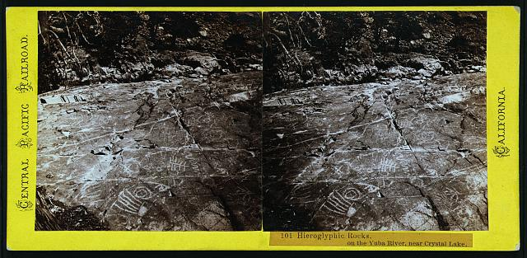
Accession control numbers
Glossary: A number or code assigned to uniquely identify a group of records or materials acquired by a repository and used to link the materials to associated records.
Usually alpha-numeric code
Can signify different hierarchical levels
Acronyms can identify organization or department
Can identify acquisition date
Other codes can represent media
Notes:
Question/Response:
How many use accession numbers?
--at the collection level?
--at the group level?
--at a more finite level?
How many use codes in their numbering schemes?
Benefits of establishing unique ID numbers
Need to use numbering scheme that is easily recognized and can be understood and used over time.
Hieroglyphic Rocks, on the Yuba River, near Crystal Lake, LOT 11477, no. 50, LC-DIG-stereo-ls00497, photo. & pub. By Alfred A. Hart, [between 1865 and 1869], part of Central Pacific R.R., California, Scenes in Sierra Nevada Mountains series, Library of Congress Prints and Photographs Division, stereo ls00497
SAA Glossary: Accession number: “A number or code assigned to uniquely identify a group of records or materials acquired by a repository and used to link the materials to associated records.”
Leave in original containers unless they are too unstable to avoid loss of information. (Refer back to preservation section)
Follow marking procedures described in preservation module.
Photo collections are often stored in separate places due to special circumstances like size of image, fragility, glass. Document location of all materials in accession record, consider using a separation sheet.
Many repositories label boxes or other housing with accessioned photographs, but some choose not to use external makings to minimize theft or unauthorized access.
Label boxes: Name of archives, Accession number, Name of collection, Description, Box number, Total number of boxes
Decide on basic housing needs and timing
Clearly mark containers or shelves with accession information
Include storage location in accession documentation
Tomato crates at the Yauco cooperative tomato growers’ association, Puerto Rick, LC-USF35-491, LC-DIG-fsac-1a34046; color slide, 1942 Jan., by Jack Delano, FSA-OWI Collection, Library of Congress Prints and Photographs Division.

Slide 7
Numbering examples
Groups
RG260
XYZ Coll 1998-135
1978:0163
ZHS:42
Items
RG7951.PH-1784
DLC/PP-2004:001.1
Ph 7 (21):1
81:15/G
Notes:
Record Group 7951, photo number 1784
LC, P&P, acc. year, 1st accession, 1st item
Photo unit, 7th group, 21st series, 1st item
81st acq., 15th item, glass plate
[Z Historical Society], 42nd acq., no item number
Value of progressive accession numbering in hierarchical system (for example, implement when items are removed from their box)
If time, allow for 5 minute discussion among groups of 2 or 3 participants, sharing information about the accessioning system they use. Possibly provide time for participants to record an example of their numbering scheme on the white board (or on large sheets)?

Slide 8
Digital photograph accessions
Process immediately
Record file format & carrier
Note whether born-digital or a scanned photograph
Copy digital file to a system that is backed up
Example: 2 digital photographs (TIFF, 24 megabytes each) received via email, 2/22/02, loaded on server 5/6/06, file names topnp/jan2004/001-002.tif

Slide 9
Deposits & long-term loans
Do not accession
Assign a deposit or loan number
Prepare documentation using procedure following accessioning pattern
Notes:
Ruined but not disheartened, his safe, his business souvenir, San Francisco, April 1906, Philadelphia : Universal View Co., c1906, ppmsca09838, LC P&P, LOT 11523.
Why accept deposits?-- maximize donor’s tax return, value exceeds liabilities, extend repository time to meet donor requirements, extend time to raise funding, special project.

Slide 10
Plan for processing
Review collection & documentation
Evaluate risk, value & use
Consider processing steps
Identify requirements & upgrades
Document strategies & outcomes
Record decisions
Notes:
Ballet rehearsals, New York City, ca. 1916: Ballet Russe Photo by Bain News Service, Library of Congress Prints and Photographs Division [LC-USZ62-63268]; cph 3b10884
Outline of proposed steps to arrange and describe material.
Can be informal for some repositories or more formal process (similar to a grant proposal if not an actual grant proposal) in other repositories. Generally crucial to perform this step when planning to undertake the processing of large collections. Routine processing can work from processing checklists (as in table 5.6, p. 157).

Slide 11
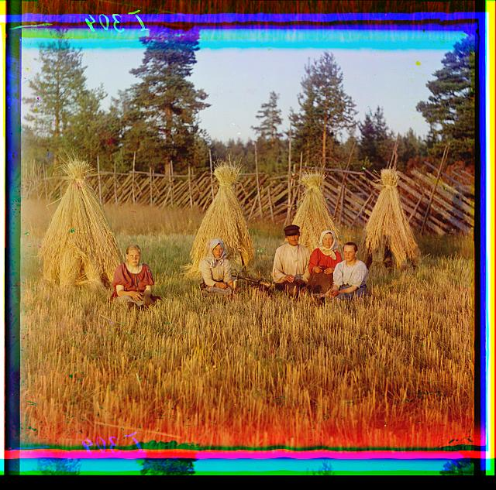
Arrangement
Glossary: The process of organizing materials with respect to their provenance and original order, to protect their context and to achieve physical or intellectual control over the materials.
Notes:
Last load, c1903 by Taber Prang Art Co., Library of Congress Prints and Photographs Division, SSF-Farm Crops-Hay [LC-USZ62-113455] cph 3c13455
Na zhnitvie. [Rossiiskaia imperiia], translation: At harvest time [Russian Empire], LC-P87-5235, digital color composite from digital file from glass neg., 3 color separation neg., [1909], Sergei Mikhailovich Prokudin-Gorskii, Library of Congress Prints and Photographs Division, prokc21027.
Typically, if photographs are in some kind of order, it is numerical (like by negative or job number), alphabetical (by name or by subject, sometimes with several series and sub-series) or chronological.
SAA Glossary: Arrangement: “The process of organizing with respect to their provenance and original order, to protect their context and to achieve physical and intellectual control over the materials.”
Arrangement of photos follows similar principles for arranging text, but there are also special considerations due to condition, multiple generations, preservation/storage requirements, lack of captions, lack of original order. Often physical format is the main criterion for establishing a series.
Determine most practical arrangement based on anticipated value, use and risk.

Slide 12
Provenance & original order
Glossary
Provenance: The origin or source of something.
Original order: The organization and sequence of records established by the creator of the records.
Notes:
When physical separation is required due to preservation and access considerations, provenance and original order can be maintained with documentation (intellectual control).
SAA Glossary: Original Order definition: “The organization and sequence of records established by the records’ creator.”
Relationship between physical and intellectual arrangement; can maintained by intellectual control without physically keeping photographs as they were. Intellectual arrangement as a conceptual grouping. Physical separation can help to improve preservation.
Fruit auctioneer and clerk eating peaches in front of livestock pavilion, Sikeston, Missouri, LC-USF33-011563-M4, from nitrate negative, 1938 May, by Russell Lee, OWI Overseas Picture Division, FSA-OWI Photograph Collection, Library of Congress Prints and Photographs Division, fsa8a23306

Slide 13
Hierarchical arrangement
Group/Collection
Series
Sub-series
File
Item (Photo)
Notes:
PACM, p. 142: “Within each format-based series, the subseries can rely on such ‘unifying elements’ as function or genre, subject, or chronology. Series may also be divided into file units or times based on a format such as a single album. Archivists try to retain whatever arrangement scheme the creator used. Similar series can be made when an archivist imposes arrangement on material that arrived without discernible order.”
In this slide, the word ‘record’ is used to signify ‘photo’ for purposes of this workshop.
SAA Glossary definitions
Sorting mail on board a mail car, LC-USF34-012946-D, safety negative, 1938, by Arthur Rothstein, Overseas Picture Division, FSA/OWI Collection, Library of Congress Prints and Photographs Division, fsa8b14712.

Slide 14
Rules of arrangement
Size
Format
Notes:
Washington, D.C. Deciding whether to buy the small can at twenty-five cents or the large can at sixty-seven cents at the Giant Food shopping center on Wisconsin Avenue, LC-USF34-100272-D, negative, June-July 1942, by Marjory Collins, FSA/OWI Collection, Library of Congress Prints and Photographs Division, fsa 8c36415.
PACM, p 142: “Physical format is frequently a primary criterion for establishing photographic series.”
Deleted: Rags. Collection and processing. A portion of the sorting room in a large Eastern rag processing plant. In this room new rag remnants, consisting chiefly of cuttings received from clothing factories, are sorted. The rags are classified and separated according to the type of cloth; colored rags are graded according to the ease with which they can be [end?], LC-USE6-D-002244, safety negative, 1942 Jan., by Howard Liberman, Overseas Picture Division, [subject is Baltimore], FSA/OWI Collection, Library of Congress Prints and Photographs Division, fsa 8b01625
Combine accessioning with physical arrangement and get preliminary descriptions. Compile container list and integrate with description & cataloging.
Impact of arrangement on description, housing & access.

Slide 15
Assembled collections
Artificial or legacy collections
Organized for browsing
Often by subject, genre or creator
Notes:
Kangaroo, 1876, Centennial Photographic Co., LOT 7756, cph3c00633, Library of Congress Prints and Photographs Division. Temptation to add to existing grouping if already sizable and incomplete.
Was typical practice for repositories to create subject files with photos from various sources interfiled according to subject or name (if biographical or geographical). Strong drive to provide access (usually self-service) according to subject, genre and creator. Smaller collections are often arranged into artificial groupings (provides context, examples are daguerreotype collections, Stieglitz collection, portrait collection), although this is not recommended for larger collections of photographs. Even if assembling a collection in this way, continue to create and retain accession information.

Slide 16
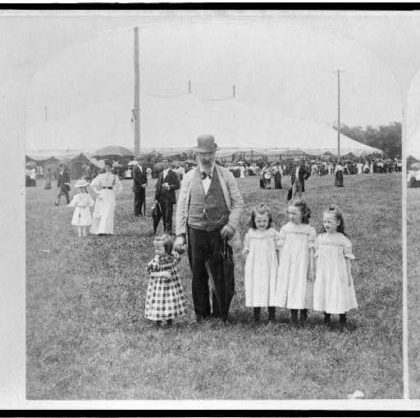
Arranging multiple generations
Matching negatives with corresponding prints
When/If to match negs and prints
Identifying numbers and codes
Decisions about copies and variants
Notes:
Triplets, Katie, Annie and Francis Cleveland Brennan, born Dec. 17th, 1890, LOT 12582, LC-USZ62-111765, ½ of stereoview, photographed and published by B.W. Kilburn, c1896. Cph3c11765, Library of Congress Prints and Photographs Division.
Same image in negatives, contact prints, enlargements, details, etc. each with different housing and handling requirements.
Systems for using numbers or codes to identify and link type and location of multiple generations.

Slide 17
Getting help
Support staff
Grant funded positions
Volunteers
Interns
Notes:
A group sorting peas at the table in Ross’s Cannery, Seaford, Del. The little fellow in the photo is a full fledged sorter. He is 5 years of age. Many such children work steadily in the Cannery, and some of them work at the machines. Location: Seaford, Delaware, LOT 7476, no. 1594, LC-DIG-nclc-00797, 1910 June, Lewis Wickes Hine, photo in Canneries album, Photographs from the records of the National Child Labor Committee (U.S.), Library of Congress Prints and Photographs Division.
True for many aspects of managing photo archives, particularly for processing efforts.

Slide 18
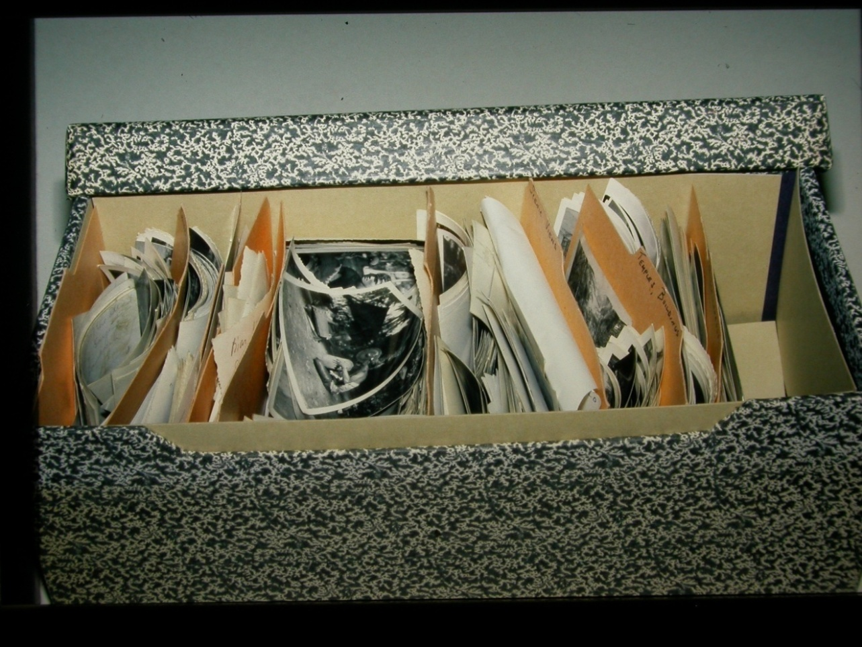
Module 3 Redux: Housing and Access
18
Notes:
This problem is not so atypical
Even without handing damage is happening.

Slide 19
How to folder and sleeve
Safe practices
Items and groups
Segregate formats
prints
negatives
transparencies
preservation masters
19
Notes:
Develop policies and write them up for all staff and users to follow. Post them for everyone to see. Don’t’ assume people know this stuff. Such as pulling the envelope away from the sleeve or envelope. Not grippin phtoographs betewen your fingers. Holding with two hands, things that we discussed yesterday.
Individually sleeve if you have the money, if not it’s ok to group However, you want to avoid slumping, so physicall support for vertically filed items.
Smaller than 11 x 14 goes into document storage box vertical storage
larger than 11 x 14 should go into a flat storage box. Sleeving applies.
Ideally if you have mixed collections separate formats and store like with like. Glass with glass, paper with paper, film with film. Also applies to physical formats Stereo with Stereo. Uses less space, allows for proper support of items and can be chemically important: nitrate/acetate also color.
In mixed collections items may have different storage needs. Film color vs prints. Don’t want to waste valuable storage space if you haven’t segregated the color out.
Glass plates stored long edge vertically if in good condition. Otherwise if broken a custom made sink mat that separates individually pieces so edges don’t grind
IF resources are limited (when are they not), then need to priotize what gets your best envioronmental conditions.

Slide 20
Marking photographs
DO’s
Record desirable or necessary info
Use pencil (#2 or softer)
Write on enclosures
Use inks responsibly
DON’Ts
Exert pressure
Write while photo is inside envelope
Mark on image or reverse of image
20
Notes:
Use solvent markers (like Sharpies) to mark plastic enclosures; mark outside of image area
Permanent but removable.
Mark as little as possible
Mark enclosures over the item itself
Pens (like pigma pens) non-image area
Inks may stain or bleed and made promote fading of the image.
If must :
Water nonsoluble
Non bleeding
Non Acidic LC ink Also use rubber stamps for ownership markings, but use ink that is nonacidic, nonbleeding, nonfading and be sure it passes the PAT.

Slide 21
Storage Enclosures and Furniture
Sleeves
Envelopes
Folders
Mats
Boxes
Frames
Shelves
Cabinets
Flat Files
Compact Units
21
Notes:
Enclosures = Housings Furniture is what you keep the housed items in.
If possible individually sleeve each item. That’s generally not practical, so identify items of particualr value, high use, and condition that may warrent the use of individal sleeves.
Levels of protection. Sleeves or envelopes to folders to boxes to sleves or cabinets. The more layers the more protection.
Good quality enclosure insulate photographs from changes in teperature and rh and harmful gasses
Boxes keep out dust and dirt.
Four-flap folders
Mats are a more expensive way to store photogarpahs – gives a lot of protection. Use photo corners over hinging. Use slipsheets to protect the photograph at the window opening
Sink mats for broken glass plate negatives, or items with fragile prints. Warped boards
Larger prints need extra support – use a backing board and polyester sleeve
Envelopes – balanced seams. Adhesives may hold mosture and if not good wont attack the middle of the image. Also plact emulsion away from seamed side.
Boxes upright and flat – greater tha 11 x 14 in flat storage box.
Furiture should not be made of wood, off gas harmful vapors, if that’s what you have then use barrier layers and devinately boxed. Sray coated stainless steel
Oversizie items can benefit from flat files.
Materials and finishes of furniture

Slide 22
Storage enclosures
Choose enclosure style based on needs of the original, such as:
Size / photographic format
Value
Condition
Demand
Resources
22
Notes:
Impact of photograph format on enclosure choice
Lantern slides call for a different storage strategy than a 30 x 40 color print.
Value – evaluate what items you may want to put into mats a Edward Weston or Southworth and Hawes Daguerreotype may warrant the best housing you can afford.
Broken glass plates will require sink mats

Slide 23
Paper and Plastic
Photographic Activity Test (PAT)
Paper -- Buffered vs. Non-buffered
Plastic
Good = Polyethylene, polypropylene, polyester
Bad = Polyvinyl chloride (PVC)
23
Notes:
Photographic Activity Test – an inernational standard that evaluates storage enclosure material and tests for gelatin staining and image fading.
Many library and museum sullpliers will say if their items passed the test. But keep in mind that while that was true at the time of testing, what if they have changed their formula ?
At LC we test every batch that comes in. Not possible for many institutions,
Paper advantages – can wirte on it. Keeps out dust and dirt.
disadvantages can’t see through it so have to handle item to see it.
Plastic – adv. See through reduces handlling
Disadv. Can’t write on it as easily
Static charge
high humidity may cause swelling of gelatin and then ferrotyping.
Buffered paper is really good for most photographic processes. The only exception is the cyaotpes. It is PH sensitive and alkaliinity in the bufferening agents can harm the image material.
High alapha cellulose, no lignen no colors
Plastic – uncoated polyester polyethylene or polyproplyene. Beward of plastics that have a frosted appearance this may be a plasticzer or abraasive.

Slide 24
Special format storage
Cased photographs
Glass plate negatives and Lantern slides
Albums and Scrapbooks
Oversized
Rolled
Framed
24
Notes:
Cased photorpahs – can be fursnighed with a custom four flap box.
Lantern slides and gpn – 4 flap non adhesive wrappers
Albums are best in custom made phase boxes or wrapper.
Oversize – panorama in folders in flat files Alternative is to roll the panoramas – a cardboard tube (good materials ) larger than the print image side in with barrier paper and polyester film on exterior
Framed – hanging on wire racks or in bins.

Slide 25
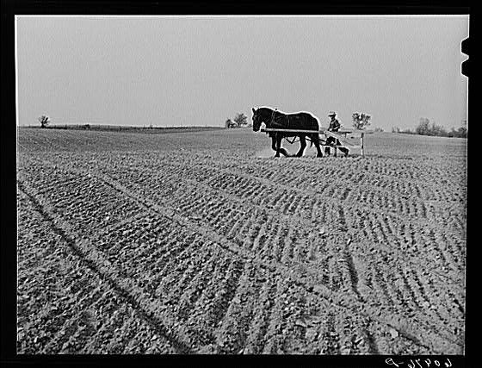
Module 6: Description and Cataloging
Glossary
Description: The process of creating a finding aid or other access tools that allow individuals to browse a surrogate of the collection to facilitate access and that improve security by creating a record of the collection and by minimizing the amount of handling of the original materials.
Cataloging: The process of providing access to materials by creating formal descriptions to represent the materials and then organizing those descriptions through headings that will connect user queries with relevant materials.
Notes:
“Marking” the field for cantaloupe planting. Plants will be put where the lines cross. Deshee Unit, Wabash Farms, Indiana.
LC-USF34-060976-D (b&w film neg.), 1940 May, John Vachon, FSA/OWI Photograph Collection, Prints and Photographs Division, Library of Congress, fsa 8c17482
Put the fields in order to make access grow. Most repositories are looking for results, not planning, but need to plan ahead to get good results.
Focus in this module will be on describing photos, but often photos are described in collections along with other media, including other graphic materials or manuscripts.
“Description often provides information not otherwise on the photographs. It is used as a document with the photographs, as well as for access to the photographs. Description often compensates for the lack of textual information on photographs.” – PACM
How is the description of photos similar to text-based and how is it different? Photographs can be published or unpublished, descriptive standards borrowed from bibliographic (emphasis on item-level, published material), archival (focus on provenance, unpublished collections with component parts) and museum worlds (focus on physical format and curatorial considerations).

Slide 26
Access techniques
Fantastic memory
Do your own thing
Follow established practices
Use standardized tools
Think outside the box
Notes:
Fortune teller and mind reader in sideshow, state fair, Donaldsonville, Louisiana, 1938 Nov. by Russell Lee, FSA-OWI, Library of Congress Prints and Photographs Division, fsa8a24243
Examples of ways to think outside the box include these alternatives: Exhibits, Online postings, Web pages, and Publications, all of which is covered more in Outreach Module 8.

Slide 27
Establish patterns
First Step:
Use the word
PHOTOGRAPHS
in your access tools!
Notes:
Bert K. Miura, pattern making, Manzanar Relocation Center, California, Ansel Adams, LOT 10479-3, no. 21, LC-DIG-ppprs-00366, [1943], from Manzanar War Relocation Center photographs,, Library of Congress Prints and Photographs Division, ppprs 00144
Importance of being consistent, provide examples of possible choices available (describe photos and manuscripts in one collection level catalog record, prepare folder level finding aids, etc.)
Organizational goals and objectives; should select practices that will fit together well, working like a descriptive assembly line, with operations seamless as possible.
Add the word photographs to guides, finding aids, catalog records, online resources and other repository descriptions as a quick and basic way to let users know where the photographs are within the collections.
Keep it simple: You don’t have to be an expert in the history of photography to make good descriptions. Use general terms for photo processes if too difficult or time consuming to be more specific. Connoisseurship not a requirement for description.

Slide 28
Common descriptive elements
Creator names, context & roles
Titles
Dates
Extent and physical description
Subjects and work types
Notes
Identification numbers
Notes:
Includes access points for creator names and subjects.
Notes include access and use conditions, rights status, acquisition & appraisal and general
ID includes reference codes and digital image links

Slide 29
1. Creator names
Multiple creators
As access points
As part of narrative elements
Clarifying context & roles
Include names even if incomplete

Slide 30
1. Creator names
Arbus, Diane, 1923-1971, photographer
Detroit Publishing Co., photographer
American Bridge Company, client
Attributed to Carlton Watkins
Includes work by Mathew B. Brady, Timothy O’Sullivan and Alexander Gardner
Published by Keystone View Company
Copyright by Walt Disney Company
Unidentified photographer
Notes:
Schools. Interior with children painting, reading and writing, LOT 12819, p. [002], LC-USZC2-4487, [photographed between 1930 and 1940?], Samuel H. Gottscho, in album titled Schools, Library of Congress Prints and Photographs Division, gsc 5a00391.
American Bridge Company constructed Golden Gate Bridge.

Slide 31
2. Titles
Value of descriptive titles
Titles for items and groups
Types of titles
Supplied
Transcribed
Notes:
Be factual and brief when supplying titles. Use consistent patterns and punctuation.
Collection titles not much different than for textual records; addition of word photo can be helpful
Deleted: [Unidentified Union officer, full-length portrait, standing, facing front], by Louis Seebohm, between 1861 and 1865, LOT 8751, no. 66, in Adolph Metzner photo album, Library of Congress Prints and Photographs Division, cph 3c29650.

Slide 32
2. Supplied titles
Patterns for supplied titles
[Name of Photographer] Collection
Photographs from [x] Collection
[Name] Family Photograph Collection
[subject], [location], [time period]
Notes:
[Chess Club illuminated. Canal Street, New Orleans, La.], c1903 by John N. Teunisson for New Orleans Railways Co., LC P&P, cph3b10769
This and following example are from the group New Orleans, La., ca. 1895-1910, LOT 5249
Some series titles are “Photographs”

Slide 33
2. Transcribed titles
Notes:
Illumination of Pickwick Club and Canal Street, New Orleans Mardi Gras, c1898 by John N. Newnisson, LC P&P, cph3b10760
Transcribed titles: [sic] = misspellings; [i.e.]=correction
Indicate transcription, esp. in cases where title is insensitive or inappropriate.

Slide 34
3. Dates
Date of creation
Date of copyright
Date of publication
Date of printing
Use estimated dates if exact date unknown
Notes:
World's Fair. Sign announcing fair closing date of 1940 Oct. 7, Gottscho-Schlesiner, Inc., LC P&P, LC-G605-00016, 1940 Oct., gsc5a30907.
No photos prior to 1839. Better to give a broad range than nothing at all. Use of approximately, between or circa depends on choice of standard.
Place of publication relevant for stereos and other published images. Do not use with unpublished photos

Slide 35
3. Dates
1890-1900
1870-1920,bulk 1895-1910
circa 1942
1880s
probably 1972
between 1912 and 1915
1887 or 1888
1960 May 17
undated
Inclusive span
Predominant years within span
Approximate
Estimated decade
Probable year
Year within a range
One of two years
Exact date
unknown
Notes:
Depending upon standard or rules adopted, could use approximately, circa, ca., n.d., undated or brackets.

Slide 36
4. Extent & physical description
Quantity of photographs
Physical description
Physical format
Genre
Size
Other identifying characteristics
Notes:
Other characteristics includes listing color or b&w, type of mount or mount size, type of case, info about photo album or other container.

Slide 37
4. Extent & physical description
2,400 photographs (12 linear feet)
2 boxes, including photographs
about 14 linear feet
692 negatives : polyester ; 4x5 in. and 5x7 in.
1 photograph : daguerreotype, hand-colored, in thermoplastic case; plate 7 x 6 cm (ninth plate), case 8 x 7 cm
Notes:
The fate that awaits the gold Germany is now paying America for food supplies, LOT 12356-2, LC-USZ62-106956, Man using a coin counting machine to count gold coins, [between 1919 and 1921], National Photo Company Collection, cph 3c06956

Slide 38
5. Subjects and work types
Of and about
Keyword and controlled access
Broad and specific subjects
Type of work: format and genre
How many access points are needed?
Notes:
Subject information appears within titles, in notes and in access points.

Slide 39
5. Subjects & work types
Deadwood, S.D.
Cities & towns
Photographic prints
Cityscape photographs
Bird’s-eye-views
Notes:
This information appears in titles, notes and access points.
Deadwood, Dakota. A part of the city from Forest Hill, LOT 3076-6, no. 862, LC-USZ62-78513, c1888, John C.H. Grabill, photographer, part of the John C.H. Grabill Collection, Library of Congress Prints and Photographs Division, cph3b25605

Slide 40
6. Notes
Access & use conditions
Rights status
Acquisition & appraisal
Scope & content
Administrative & biographical
General
Notes:
Provenance info, including sources, date, organization & arrangement.

Slide 41
6. Notes
Title from caption mounted on back of photograph
Title devised OR Title supplied
No known restrictions
Rights not evaluated
Publication restricted: Image protected by copyright
Access restricted: Serve by appointment only
Please use digital image or other reference copy. Original photograph is too fragile to serve
Forms part of the [name] collection
Gift of Marian S. Carson, 1996
Notes:
Title translated/continues, publication or citation info, summary/historical note, other numbers

Slide 42
7. Identification numbers
Unique identification numbers
Reproduction order numbers
Digital identification numbers
Bibliographic record numbers
Notes:
Points to relationships

Slide 43
7. Identification numbers
Repro: LC-USF34-T01-009058-C
Print: LOT 0344
Digital ID: fsa 8b29516
Bib. record: fsa1998021539/PP
Notes:
Example from bib record at LC, P&P for migrant mother (Destitute pea pickers in California. Mother of seven children. Age thirty-two.)
This catalog records includes other numbers as well, one for b&w film copy transparency, b&w safety neg., longer version of digital id number, call number and other.

Slide 44
Descriptive elements
Notes:
How would this photo be described using the 7 elements? Actually only five, since no known photographer and no ID number.
Creator names, context & roles: unidentified photographer
Titles: supplied title: [Group portrait inside Quynn’s Hardware Store, Frederick, Maryland]
Dates: ca. 1930
Extent and physical description: 1 photograph on mount: gelatin silver
Subjects and work types: Group portraits, Hardware stores, Interiors, Store employees, Frederick, MD
Notes: Identification of sitters, address of store…
Identification numbers: n/a

Slide 45
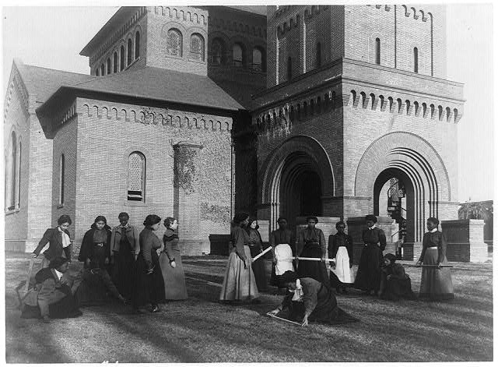
Hierarchical description
Collection
Series
File unit
Item
Notes:
“…collective summaries and finding aids are critical for successful management of the large quantities of unpublished, documentary photographs held by many institutions. …also recommends selective item-level description for high-value and high-use photographs.” (PACM, p. 159)
Measure choices based on needs and resources.Vary depth of description based on value, use, risk, institutional mission.
Review from arrangement chapter levels of arrangement, now incorporate same principles into determining desired level of description.
[Girls measuring piece of ground in arithmetic class at Hampton Institute, Hampton, Va.], LOT 11051-4, LC-USZ62-94864, [1899 or 1900] Frances Benjamin Johnston, FBJ collection, Library of Congress Prints and Photographs Division, cph 3b41031
Types of collections: original order, artificially arranged, mix of photos and negs (multiple generations, varied sizes and formats), mix with other collection materials.

Slide 46
Collection-level description
Glossary--Collection: A group of materials with some unifying characteristic.
Record Group: A collection of records that share the same provenance and are of a convenient size for administration.
General access to holdings
Summary demonstrates breadth of collection
Recommend collection-level summaries before providing detailed access to selected collections
Notes:
Glossary: Records Management: The systematic and administrative control of records throughout their life cycle to ensure efficiency and economy in their creation, use, handling, control, maintenance, and disposition.

Slide 47
Series-level description
Glossary—Series: A group of similar records that are arranged according to a filing system and that are related as the result of being created, received, or used in the same activity;
Describes groups within larger groupings
Focus on commonality
Useful in multi-level catalogs
Importance of linkage to record groups, sub-series, collection and item-level description

Slide 48
Item-level description
Glossary—Item: A thing that can be distinguished from a group and that is complete in itself.
Direct access to popular images
Reduce handling
Appeal of providing item-level description for selected online images
Notes:
Selective item level description along with digital image access to some photos online can be useful. Ideal situation is to use a combination of item and collection level description.

Slide 49
Traditional access tools
Glossary:
Guide: A broad description of the holdings at one or more archives, typically at the collection level.
Finding aid: A tool that facilitates discovery of information within a collection of records.
Catalog: A collection of systematically arranged descriptions of materials.
Programs & applications
Notes:
Distinction between these types not necessarily distinct, especially now that so much is online.
[Routt National Forest, Colorado. U.S. Forest Service shed showing tools and canned food inside], LOT 12352-8, [between 1909 and 1932], National Photo Company Collection, cph3c00990, LC P&P Description & cataloging activities: Gather tools--Look at photos--Review existing information--Add info as needed--Research creators--Analyze info--Write overviews--Identify media & extent--State usage criteria--Assign access points--Encode descriptions--QA/QC--Update as needed
Guides: Overview of resources-Usually at collection level; Summaries of holdings-Generally mentions creator(s), title, dates, extent and physical description, reference code-Sometimes includes subject notes and usage conditions; Usually arranged numerically or alphabetically; Guide: to department, repository, or regional collection. Can be based on theme (photos, religious archives); illustrate guides with photos!
Finding aids Summarize entire collections, Extensive series or container level info., Unlimited number of entries/pages connects levels. Includes: Inventory, Register, Logbook, Database, Container lists
Catalogs Summarize entire collections, Multilevel description sometimes possible, Hierarchical linkage connects level
Typically finding aids provide an overview along with summaries of component parts and a contents or container list at either the box, folder or item level (in the case of photos).

Slide 50
Hands-On Learning Activity
Elements to locate
Creator names/context/roles
Titles
Dates
Extent & physical description
Subjects & work types
Notes
Identification numbers
Name of repository/digital library
Notes:
This photo is from the Getty example.
Remember that when the cataloging was done and the bib record was made impacts application of descriptive rules. Some work with legacy cataloging, some make conversions.
We are only reviewing the records, not the entire web site so we have no information in hand about what might be on other pages regarding such topics as how to access originals or ordering copies.
GROUP DISCUSSION: Use of common descriptive elements
Quality of descriptive & interpretive information
Missing or confusing areas
Desirable enhancements
Is less more?
What is best fit for you?
These records are all available online. How does that impact description?
Conclusions?

Slide 51
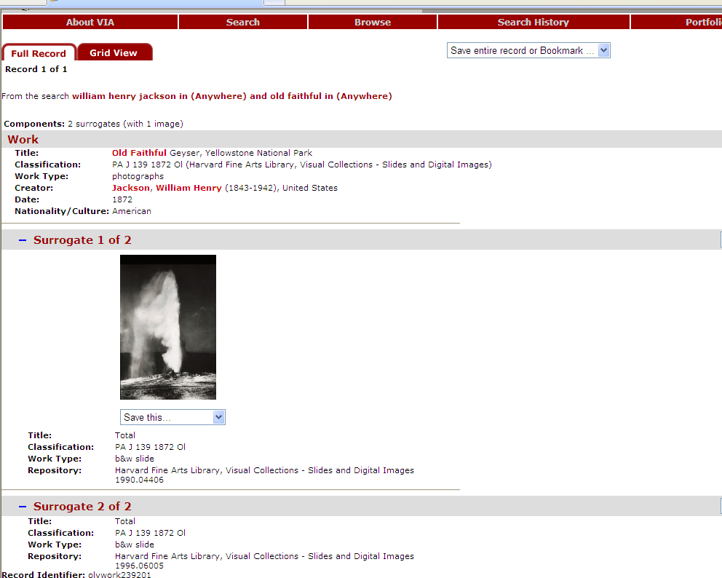
2
7
5
1
3
6
4
8

Slide 52
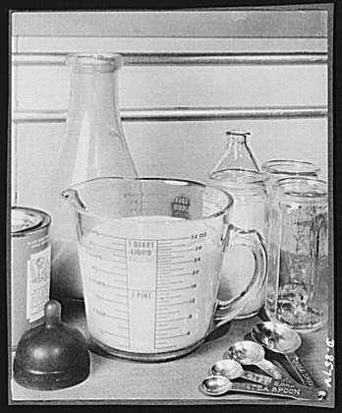
Using standards
Benefits
Easier to share info resources
Provides structure
Uses best practices
Easier to control what is produced
Doesn’t reinvent wheel
Costs
Takes time to learn
Less freedom
Adds cost
Notes:
Substitute materials. Glass utensils. New type glass measuring cups have easy-to-read markings…, 1943 Jan., FSA-OWI, LC P&P, fsa8b09820
Staff: salary, training, benefits
IT: hardware, software, network connections, data storage, membership in local consortiums
Standards: publications, training,
Reference sources: Published tools, database access, memberships
Risk: inaccurate description, poor processing, misinformation. Prevention techniques includes QA/QC on records, documenting procedures and policies, soliciting and responding to user feedback, sharing information.
BALANCING DESCRIPTION SLIDE DELETED: COSTS: Staff time to describe, Information technology expenses, Standards, Reference sources, Indirect costs, Risks
BENEFITS: Ease search & find, Facilitate info exchange, Reduce unnecessary handling, Fulfill institutional mission & goals, Provide meaning, Enhance understanding of value

Slide 53
Cataloging standards
Glossary—Standard: A benchmark or reference used to measure some quality or practice.
Data standards
Data structure
Data content
Data value
Notes:
Could use example of any common element, including date, title, control number, subject or extent. The following slides give the look and feel of each tool using the date element as an example. Explain reasons each tool has value and how to make choices.
Survey participants throughout to discover who is using what.
Bakersfield. A cottage home, Black Hamburgs, LOT 3379, LC-USZ62-98347, by Carleton E. Watkins, [1888], cph3b44431
Many standards are general, not particularly for photo cataloging.
SAA’s Standards for Archival Description available online, 1994 by Victoria Irons Walch

Slide 54
Data structure standards
Glossary: A formal guideline specifying the elements into which information is to be organized.
CDWA
Dublin Core
EAD/EAC-CPF
MARC21
METS/MODS
VRA Core
Notes:
[Construction inside ship], LOT 12353-1, LC-USZ62-97819, possibly during WWI, [between 1909 and 1930], National Photo Company Collection, cph 3b43911, Library of Congress Prints and Photographs Division. See Table 6.7, p. 201-202, PACM, for data structure standards.
Brief overview of prevalent standards. Focus on providing information that will be understood over the long-term instead of the coding scheme.
MARC21: use of codes for fields, indicators and subfields to indicate type of distribution, publication, manufacture (name and place) as well as type of date.
MAchine Readable Catalog (MARC 21): Format for Bibliographic Data http://www.loc.gov/marc/marcdocz.html
Understanding MARC Bibliographic Machine-Readable Cataloging http://www.loc.gov/marc/umb/
Dublin Core: uses ISO 8601 for coding date (YYYY-MM-DD)—date of creation or availability
DC Metadata Element Set (simple or qualified DC): http://dublincore.org/documents/dces/
Standard for cross-domain information resource description; standard for web-based resource description.
EAD: Element for Date and UnitDate—date of creation, date of birth of subject, date of acquisition, date of event. Single or range of dates. http://www.loc.gov/ead/ Can use with ATTRIBUTES: NORMAL (YYYYMMDD), TYPE (publication, acquisition), CERTAINTY (circa, approximate, exact), CALENDAR (Gregorian default), ERA default is Christian era.
Standard for marking up finding aids of archival collections using XML, showing hierarchy of collection and its parts.
METS: Metadata Encoding and Transmission Standard—XML format for complex digital library objects. Uses datetime of creation in Attribute Created.
“The METS schema is a standard for encoding descriptive, administrative, and structural metadata regarding objects within a digital library, expressed using the XML schema language of the World Wide Web Consortium.”
CDWA: CDWA: Categories for the Description of Works of Art http://www.getty.edu/research/conducting_research/standards/cdwa/
CDWA: guidelines for formulating the content of art databases.
Describes: works of visual culture, images that document them and collections.
Dates: creation, design, beginning, completion, alteration, restoration. Free text or numerical entry, using AACR, DC, etc.
Comparison to VRA CORE=Date and Visual Document Date; to CDWA=Creation-Date; to DC=Date, Coverage

Slide 55
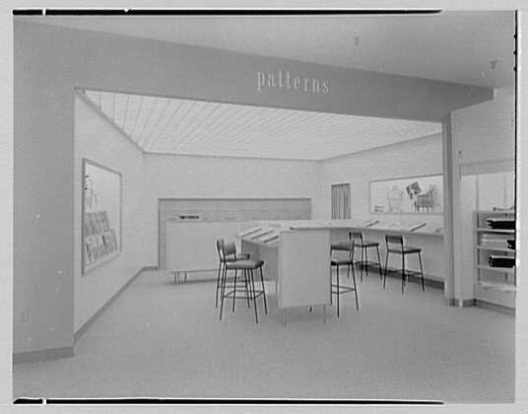
Data content standards
Glossary: A set of formal rules that specify the content, order, and syntax of information to promote consistency.
RDA
DACS
GM/DCRM(G)
CCO
Notes:
Burdine’s department store, business in Miami Beach, Florida. Patterns, LC-G613-64715, safety neg., 1953 Dec. 26, Gottscho-Schleisner, Inc., Raymond Loewy Associates (client), Gottscho-Schleisner Collection, Library of Congress Prints and Photographs Division, gsc 5a22618.
See Table 6.7, p. 200-201, PACM for list of standards. This talk will focus on the 4 listed standards.
Emphasis on visual tools and rules related to photo description
Other standards include: RAD and ISAD(G). RAD is Rules for Archival Description, published by the Bureau of Canadian Archivists. ISAD(G): General International Standard Archival Description (2000) from International Council on Archives, www.ica.org.
Content standard written to somewhat different audiences, whether mostly unpublished archival materials, published bibliographic resources, original materials (as in museums or archives) or a collection of duplicates (as found in a slide library)

Slide 56
Resource Description & Access
RDA
Replacing AACR: Anglo-American Cataloging Rules
Prospectus available at: http://www.collectionscanada.ca/jsc/rda.html
Notes:
Hopes to incorporate more visual materials and other special materials, using such standards as ISAD(G) and DACS.
Was AACR3, now renamed; was to be 3 parts, now 2.
Part A is descriptive; Part B is Access Point Control.
Draft of Part A is available.

Slide 57
Describing Archives: A Content Standard
DACS
Replaces Archives, Personal Papers and Manuscripts as a content standard
Includes examples of encoding
Notes:
Contains many photo examples and examples of other media. Gives suggestion to look at visual-only tools. Gives possibilities for ways to include photos in titles. Includes encoded examples. More plain language. If you are in the US and incorporating a small body of photos within a largely ms. coll., this might be a good fit.
Can use companion standards. Gives rules for supplied titles (series in broader coll.)
Issues in updating older records (like the no square bracket rule).
See DACS, pp. 24-28:Types of dates: Date(s) of creation, Date(s) of record-keeping activity, Date(s) of publication, Date(s) of broadcast; Single dates and ranges of dates, including estimated dates (encouragement to be consistent): Probably 1867; Approximately 1925; After 1867 January 5; 1892 or 1893; 1890s; Circa August 1975

Slide 58
Descriptive Cataloging of Rare Materials (Graphics)
DCRM(G)
Replacing Graphic Materials (Rules for Describing Original Items and Historical Collections)
Revision in development with ACRL/RBMS DCRM suite
http://dcrmg.pbworks.com/
Notes:
Especially helpful with titles, physical description and notes. Item level guidance.
National standard supplement to Chapter 8 of the Anglo-American Cataloguing Rules, which focused on modern, published audiovisual materials
Dates for published and unpublished material. Single dates, supplied dates or range of dates, including month and day. Rules for entering copyright date after date of execution, entering date of printing or publication in addition to date negative was made.
[between 1999 and 2005]
[photographed 1863, printed 1970]
1908-1924, bulk 1910-1915]
1886, c1901
DCRM(G) 2nd edition of GM by the Bibliographic Standards Committee of the Rare Books and Manuscripts Section (RBMS) or the Association of College and Research Libraries. Wiki publicly available at: http://qcrmg.pbwiki.com. Comparison in place by June 08.

Slide 59
Cataloging Cultural Objects
CCO: A Guide to Describing Cultural Works and Their Images http://www.vraweb.org/ccoweb/
Visual resources/cultural heritage descriptive metadata
Related to CDWA and VRA Core: Visual Resources Association Core Categories http://www.vraweb.org/vracore3.htm
Notes:
CCO is Cataloging Cultural Objects (descriptive metadata for the CDWA framework: Categories for the Description of Works of Art).
Symbiotic relationship with VRA core and CDWA. For Art and Image collections (slide libraries) primarily, visual resources as well as cultural heritage community.
CDWA: guidelines for formulating the content of art databases.
Describes: works of visual culture, images that document them and collections.
Dates: creation, design, beginning, completion, alteration, restoration. Free text or numerical entry, using AACR, DC, etc.
Comparison to VRA CORE=Date and Visual Document Date; to CDWA=Creation-Date; to DC=Date, Coverage
END of date example

Slide 60
Data value standards
Glossary: An established list of normalized terms used as data elements to ensure consistency.
Access point: A category of headings in a catalog that serve a similar function.
Controlled vocabulary: A limited set of terms and phrases used as headings in indexes and as access points in catalogs.
Authority record: An entry in an authority file that contains information about the preferred form of a name or subject heading.
Notes:
MEMBER OF THE DONALD DANNHEIM FAMILY WHO OPERATE A DAIRY AND ICE CREAM STORE. BOTTLING MILK IS THE MAJOR PART OF THE BUSINESS DANNHEIM IS WORKING HARD TO RETAIN THE 10-CENT PRICE FOR CHOCOLATE ICE CREAM BARS. HE AND HIS FAMILY FREQUENTLY ARISE AT 5 A.M. IN THE SUMMER TO HAND MAKE AND HAND WRAP THE BARS. NEW ULM IS A COUNTY SEAT TRADING CENTER OF 13,000 IN A FARMING AREA OF SOUTH CENTRAL MINNESOTA FOUNDED IN 1854 BY GERMAN IMMIGRANTS, 07/1974, Environmental Protection Agency, Record Group 412. Still Pictures Branch, NARA, Part of: Series: DOCUMERICA: The Environmental Protection Agency's Program to Photographically Document Subjects of Environmental Concern, 1972 – 1977, ARC ID: 558350, slide, Flip Schulke, photographer.
See citations for authority files in Table 6.6, p. 198-1991, PACM.
Access points represent names, organizations, events, subjects, places and formats in a standardized format.
Subdivisions provide for a hierarchical string indicating nationality, geography, chronology, and topics.
Lois Mai Chan, LC Subject Headings: Principles & Application (1986).
SAA Glossary: Authority control is “the process of establishing the preferred form of a heading, such as a proper name or subject, for use in a catalog, and ensuring that all catalog records use such headings.” (consistency)

Slide 61
Keywords and tagging
Notes:
Flickr tag cloud, September 15 2010

Slide 62
Topical access points
LCSH
LCTGM
AAT
Notes:
Damas. Tombeau de Saint Jean dans de la grande mosquee / Bonfils, LOT 13550, no. 260, albumen print, [between 1867 and 1899], tomb of John the Baptist in the Great Mosque, Damascus, Syria, Maison Bonfils (Beirut, Lebanon), Library of Congress Prints and Photographs Division.
See PACM table 6.6, p. 198-199 for subject authority file listings; see Table 6.7, p. 202, PACM for general Data Value Standards (country, date/time, relators).
Choosing more visual access points can help to branch out.
Other standard specialized sources for subject headings include; Australian Pictorial Thesaurus, Canadian Subject Headings, Medical Subject Headings, Thesaurus of University Terms, Sears list, National Agricultural Library thesaurus, etc.

Slide 63
Library of Congress Subject Headings
LCSH
265,000 subject authority records, standard set of topical words and phrases
http://authorities.loc.gov/
Notes:
LCSH authorities has the term Chandeliers with a BT to Lamps. MARC coding. Hierarchical relationships.

Slide 64
Thesaurus for Graphic Materials
LCTGM
A thesaurus of over 7,000 terms for indexing visual materials, as well as numerous cross references. New terms are added regularly.
http://www.loc.gov/rr/print/tgm1/
Notes:
TGM has the term Chandeliers with a BT to Light fixtures. Hierarchical.
3rd edition available online with integration of tgm1 and 2, downloadable
TGM I: Summary of Features
I.A. Scope and Purpose
I.B. Term Selection and Formulation
I.C. Structure and Syntax : I.C.1. Relationships I.C.2. Syntax I.C.3. Facet indicators I.C.4. Notes I.C.5. Filing conventions
I.D. Relation to Other Cataloging Tools
I.E. MARC Coding
I.F. Significant Changes from the First Edition
II. Indexing Images: Some Principles
II.A. What to Index?
II.B. "Of" and "About"
II.C. Proper Name Indexing
II.D. Generic and Specific
II.E. Subject Headings as Compared With Genre and Physical Characteristic Headings
III. Subject Heading Strings and Subdivisions
III.A. Nationality Subdivisions
III.B. Geographic Subdivisions
III.C. Chronological Subdivisions
III.D. Topical Subdivisions
III.E. Combining Subdivisions
IV. Indexing for Manual Files
V. Proposals for New Terms and Changes
VI. Future Prospects for TGM I

Slide 65
Art & Architecture Thesaurus
AAT
Structured vocabulary containing around 131,000 terms and other information about concepts.
http://www.getty.edu/research/conducting_research/vocabularies/aat/
Notes:
AAT has the term Chandeliers, robustly defined with hierarchy and cross references as well as related concepts and sources. Note: “Lighting devices designed to hang from the roof or ceiling having two or more branches, usually upcurving holding candles, burners, or lamps, often ornamental.
Hierarchy: Chandeliers: Lighting devices: Furnishings: Objects.

Slide 66
Name authority files
Glossary: A compilation of authority records that describe the preferred forms of names used as headings in a catalog, along with cross-references from variant forms of the name.
Personal names
Family names
Corporate names
Organization names
Event names
Geographic names
ISAAR (CPF)
Notes:
International Standard Archival Authority Record for Corporate Bodies, Persons, and Families (2003), from International Council on Archives, Committee on Descriptive Standards, www.ica.org.
ULAN (Getty)
ARC ID: 516781, National Archives and Records Administration, National Archives at College Park-Archives II, negative, Photographing in high places. Lincoln County, Wyoming. William Henry Jackson and Charly Campbell in picture, 1872, Dept. of the Interior, Hayden Survey, Record Group 57, Hayden Survey Series, William H. Jackson Photographs, 1869-1878. NAIL: NWDNS-57-HS-172
GEH database no longer online? Static since ’02, Telnet to login, then WHJ info includes life dates, active dates, see also references, affiliated collections, exhibition history, citations, nationality, name variations, place of birth and death. Not an authority, doesn’t follow CPF rules, but good resource for photographer names, esp. relatively obscure ones.

Slide 67
Metadata
Glossary: A characterization or description documenting the identification, management, nature, use, or location of information resources (data).
Descriptive
Structural
Administrative
Technical
Rights
Preservation
Notes:
[Meta, general view, Italy], LOT 13434, no. 116, [between ca. 1890 and ca. 1900], ppmsc06544, LC P&P, photochrom, part of Views of architecture and other sites in Italy.
NISO’s (National Information Standards Organization) Understanding Metadata, 2004, www.niso.org
ADD IN MORE METADATA STANDARDS?
Descriptive: ID & Discovery (Title, creator, subj.)
Structural: structure supporting use of compound objects like albums, page turning
Administrative: use, management, encoding with subsets:
Technical: physical characteristics=creation, storage, formats of dig obj.
Rights: intellectual property rights
Preservation: provenance & management of resource
PREMIS: Preservation Metadata Implementation Strategy

Slide 68
Describing digital photos
Use the word ‘photographs’
Use sustainable electronic addresses
Reference the digital aspect
Name the specific file type
Check file header for information
EX: 69 photographs (digital) : TIFF
Notes:
SAA Glossary: Digital photo is “An image produced using a digital camera and stored as an electronic file.”
2-D, visual content, scanned and born digital
Technical Metadata for Digital Still Images

Slide 69
When resources are limited
Begin with the basics
Build upon description step by step!
Notes:
Wells Cathedral: Stairway to Chapter House, PH – Evans (F.), no. 12 (B Size), LC-USZ62-41655, platinum print, 1902, by Frederick H. Evans, cph 3a41981.

Slide 70
Module 7: Copying & Digitization
copying
duplication
reformatting
70
Notes:
Integral part of managing photo archives
Copying: most general and least precise It’s the umbrella term
Duplication: new version in same media as close to original as possible but not exact
Reformatting: preserve to a different format dissimilar media such as print to microfilm or digitizing
REASONS FOR COPYING (open up for comments)
Increase access
Reduce handling
Preserved deteriorted image
Outreach
Create surrogates
Document condition
Security
Provide offsite study

Slide 71
Copying Options
Preservation masters
Viewing copies
Copy photographs
Photocopies
Digital images
71
Notes:
Meaning photogrpaphs as the copy Vs the original
Preservation masters – LC still uses but less and less (chicago albumen works – for instance)
Becoming obsolete because of digital age
However examples may be in your collection
Concepts that applied to traditional photographic copying of collection material apply to digital medium
VIEWING COPIES
Preservation strategy – reduces handling
Possibly more stable than original
Much of the initial cost is in the capture – relatively easy to copy from there. E
Each of the bottom 3 are options for copying – each have value and different appications uses.

Slide 72
Who makes copies?
Researchers
Staff
Contract staff (in and out of house)
Commercial labs (out of house)
72
Notes:
Think of your instituion’s policies – do you allow reseqarchers to use their own camera to copy,
Photocopier
You may have staff photographer to handle reproduction requests for patrons or publication
Or the institution may contract out the work
Commercial labs for larger projects

Slide 73
Copy services
Legal issues
Fees and payment plans
Mitigating risks
Self-service copying policies for researchers
Forms needed: Order form, copyright/permission form, fee schedule
73
Notes:
Compare in-house, self-service and commercial photographic services
Discuss copy practice in participant organizations
Copyright beyong scope of this discussion but rights to reproduce should be taken into account – does the instution have the right to copy
Check with similar instituios/repositories for comparison.
RISKS – preservation/handling
legal issues for institution
plus hidden costs for institutions
Self-service coping policies for researchers specifying what can be copied and how to handle items during process.
FORMS to protect instituion and guide user what they may or may not do with the copies – one time use, publication restrictions
lay it all out clearly state the rules

Slide 74
Use and reproduction policies
Copyright
Restrictions
Sensitive photographs
74
Notes:
COPYRIGHT = stamps that indicate instuttion and copyright status
READ STAMP FROM BOOK
RESTRICTION due to fragility of objects
demand on the originals
specifications from donor
SENSITIVE PHOTOGRAPHS culturallly sensitive a hanging or alcoholics anonyous

Slide 75
Photocopying
Typically used in photo research
Preservation-quality photocopies
Handling procedures
75
Notes:
Inexpensive – usually low quality unless you make
PRESERVATION PHOTOCOPIES
use all cotton paper, buffered, high alphacellulose lignen free
with barbon based toner fullly bonded to paper – there is a tape test that you can perform
Used to copy items that are on inherently unstable media such as newspapers.
Use special copier to avoid breaking the spine of books
Watchout for curved mounts (such as stereos) that are curved – don’t force a lid
Light exposure probably not a big issued unless the item is high use, or photogenic drawings

Slide 76
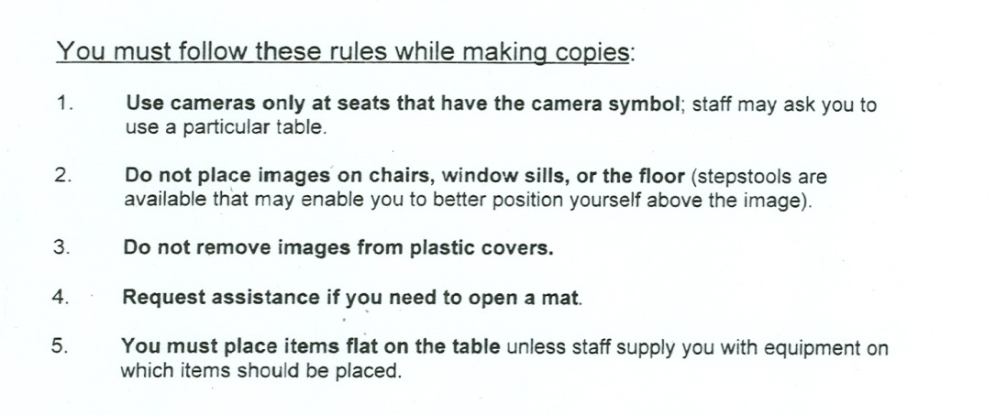
Self-service copying
Equipment requirements
Need for staff to monitor activity
Importance of posting rules
76
Notes:
Equipment: When researchers provide own equipment to copy, issues include space, availability of electrical outlets, number of people that can work at one time.
Preferable to provide copy stands for researcher use.
IF you have bound material (not just flat items such as manuscripts or prints get a copier that can accommodate the structure
Restrict 1 fragile mounts 2 light sensitive photographs – proof prints
Size considerations
Use of fasteners
Special formats
Handling procedures
Light exposure

Slide 77
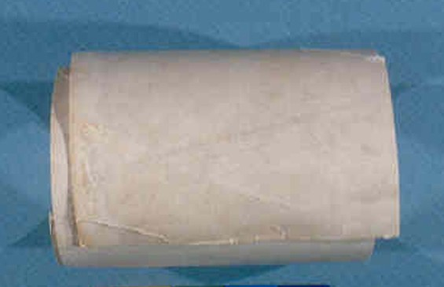
Use Caution!
Special restrictions on:
Prints on curved mounts
Salted paper prints
Pages in albums or scrapbooks
High value items
Items in poor condition
77
Notes:
Salted paper prints, photogenic drawing, proof prints, items with color dyes
Albums – pages fragile and often adhesive is failing and photographs easliy fall out.
Do not copy high value items over and over – copy once and then make derivatives
Digital format is a good strategy for this.

Slide 78
Microfilming
Preservation microfilming
Drawbacks (time, labor, expense)
Problems with non-preservation quality microfilm collections
78
Notes:
Microfilm – continuous tone - manufactured with formulations that make a great copying medium better than regular film.
If processed well and toned a very stable medium
Had it’s place, but largely replaced
1advantages dosent’ require a computer to read
However if not done to preservation standards (there are some!) then information can be lost and in many casese originals have been discarded
PROBLEMS: acetate film – LC dedicates a very large amount of space in cold vaults to preserve redox – fading from poor quality in beginning
Object lesson in doing it eight and preserving originals

Slide 79
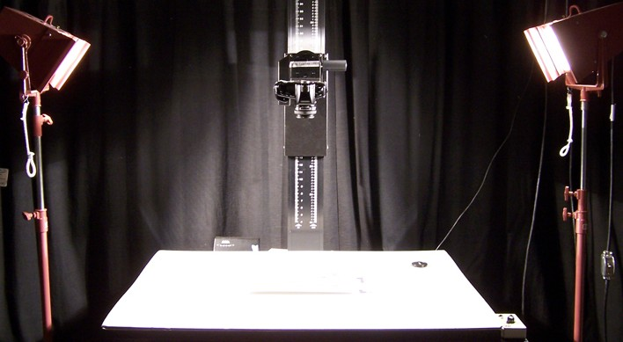
Copy Photographs
Common copy formats:
B/W and color prints
Copy negatives
Color transparencies
Interpositives, roll or sheet film
79
Notes:
Some image quality always lost – but can be hard to id as copies
B/W and color prints, 8x10 in.
Copy negatives, 4x5 in. and 35 mm.
Color transparencies, 4x5 and 35 mm.
Interpositives, roll or sheet film
Context is key
Image artefacts as tip offs
Look at edges copy negatives margins visible or a color bar

Slide 80
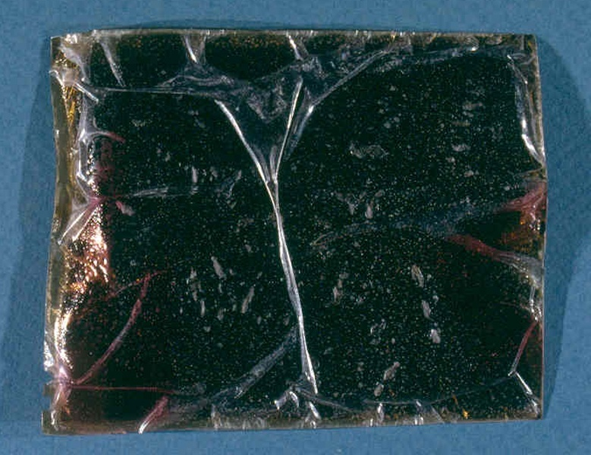
Duplicating Negatives
For unstable films and cracked or broken glass
Interpositive process
Preservation masters
Duplicate negatives
Contact printing
Copy negatives
80
Notes:
Example of chicago album works still LC uses (very costly)
Method of photographically copying more uncommon now but used to be standard
Taking a NEGATIVE –to produce a negative must have inbetween stage
INTERPOSITIVE – vastly superior “copy positive” to make preservatio masters negatives and copy negatives

Slide 81
Digitization: Benefits
Preservation
But there are also risks!
Increase Access
Increase Outreach, Fundraising
Develop Technical Capabilities
Collaborate on Virtual Collections
81
Notes:
Who is working on a digitization project now
Go around see scope,
RISKS – damage to objects in scanning process, and increased demand for originals
Can use the opportunity to rehouse a collection if already taking out of sleeve, put it into a new one
Ver useful outreach, raise public awareness of your collection
Can charge for copies
Documetation of items at a certain time and place
Uses: web, email, print, diigital presentations, preservation of content

Slide 82
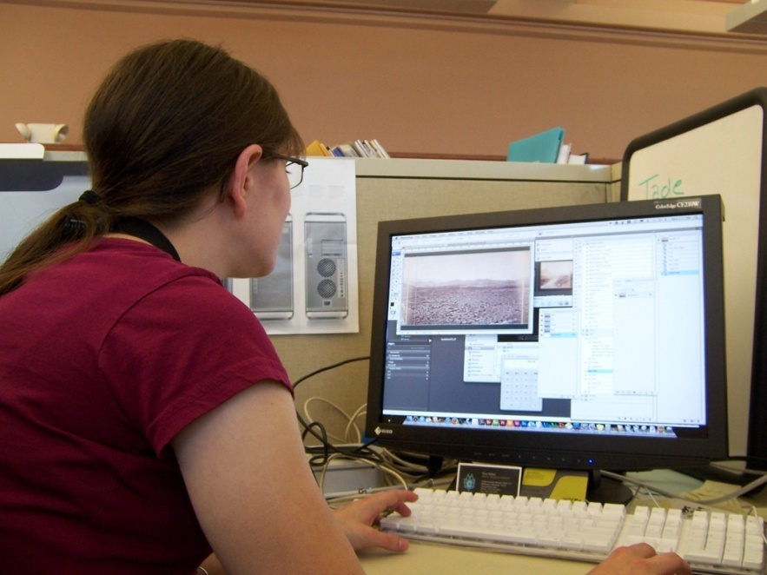
Planning for Digitization
Institutional Mission and Policy
Technical Support
Policies & Procedures
Selection
82
Notes:
Any digital project has to be done thoughtfully consiously.
Review your mission statement to see how a digital project might fit into and use policies
Obviously need technical support but you have to understand well even of outsource. Like buying a car don’t’ have to be a mechanic, but need to well informed to make sound choices.
All collection policies are likely to be involved – preservation, use,
Few instituions set out to scan everyting

Slide 83
Planning for Digitization II: Selection of Collections
Content and Audience
Physical Characteristics & Condition
Arrangement & Description
Rights
83
Notes:
Does the project have a specific audience
Will it need conservation
Is it catalogued
Do you have the rights
Are there awkward formats and therefore require extra equipment

Slide 84
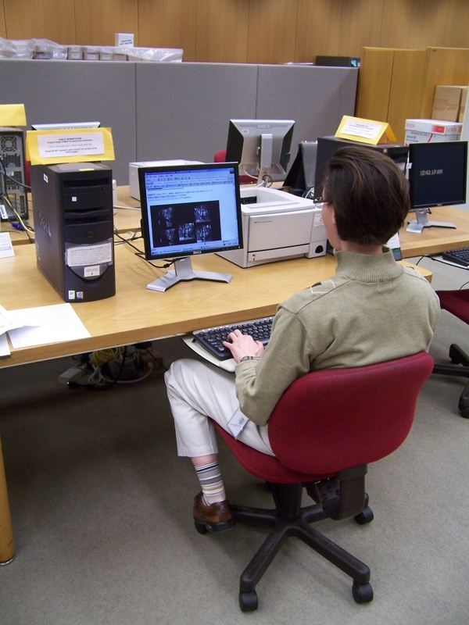
Planning for Digitization III
Technical Specifications
Staff Responsibilities & Expertise
Planning Description & Access
Management & Preservation of Digital Assets
Budget & Timeframe
84
Notes:
Start small and build up expertise
Set technical specifications before hand
Plan exactly who does what – use all availble existing expertise in institution
Plan for metadata – aka cataloguing
Plan for upkeep of your new digital collection i.e. storage, refreshment, migration
Plan workflow budget and time frame as well you can
If already underway – take the time to evaluate - how is it going – does it fill the goals you’ve set
Are their gaps in planning that you can fill in

Slide 85
Digital Imaging Guidelines
Recommendations, NOT Standards !
File Naming
Descriptive
Sequential
Directory or Folder Structure
85
Notes:
Try to make your practise fit with others so that your digital collectiosn can be compatable with shared resources, online catalogues and shred repositories
Recommendations NOT standards - but there are iniditatives – LC participates in a ____________
Judgement for your uses/needs will you make rich digital masters? Or will it be for web use only.
Will your naming conventions be descriptive i.e. accession number or sequential as things get scaned or a combination
Don’t use spaces use _

Slide 86
Image Specifications
Spatial Resolution
Enough dpi to capture detail
Tonal Resolution
Color, bit-depth, dynamic range
Tonal Mapping
Range of tonal values
86
Notes:
This is the part that can be a bit intimidating but with a little reading and plaing with a scanner you can get enough of an understanding to know what you need to look for, or what’s wrong etc.
Take a few sample objects and scan them changing all the settings to see how the end result is affected (image quality, file sizes etc)
DPI dots per inch - more dots more data more detail more money
Resolution can also dependent on other factors
tonal resolution
what color space are you using CMYK, RGB, LAB
Bit depth – how many colors are represented
Dyamic range – different between lightes and darkets
Tonal maping set white and black points 0-256 operator sets with eyedropper

Slide 87
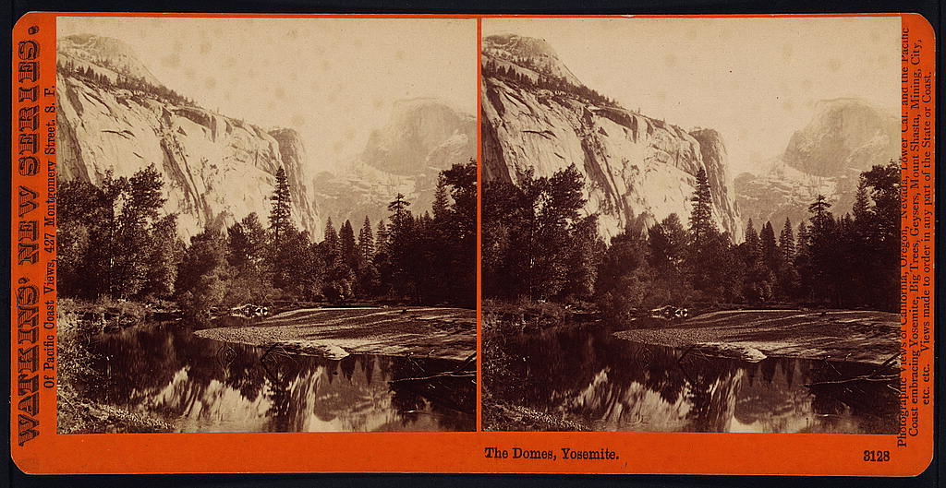
Digital Master Specifications
How much of the original will be captured?
87
Notes:
Answer these questions:
Do you want to capture the texture?
The object as it is or as it might have looked?
Should you use grayscale for modern black and white prints or bw negatives or use color which is a much bigger file but can render color. An albumen print is monotone, but not neutral black it’s purplybrown.
Do not use lossy formate use RAW and TIFF open sources not proprietary - these will be easier to handle later and are more accessible to everyone.
LC does grayscale modern bw prints and all bw negs Smithsonia and Natural History does color
But is 3x th size to store and complexity of color more challenging

Slide 88
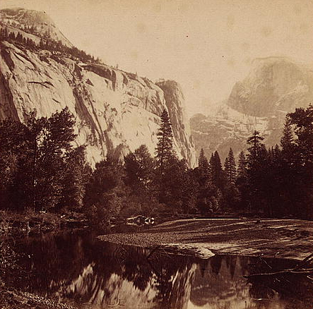
Digital Master Specifications
How much of the original will be captured?
88
Notes:
Answer these questions:
Do you want to capture the texture?
The object as it is or as it might have looked?
Should you use grayscale for modern black and white prints or bw negatives or use color which is a much bigger file but can render color. An albumen print is monotone, but not neutral black it’s purplybrown.
Do not use lossy formate use RAW and TIFF open sources not proprietary - these will be easier to handle later and are more accessible to everyone.
LC does grayscale modern bw prints and all bw negs Smithsonia and Natural History does color
But is 3x th size to store and complexity of color more challenging

Slide 89
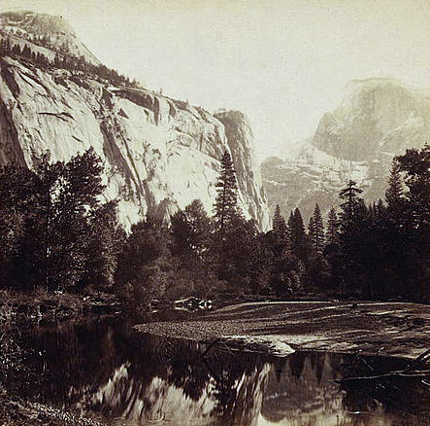
Digital Master Specifications
Actual or idealized image?
89
Notes:
Answer these questions:
Do you want to capture the texture?
The object as it is or as it might have looked?
Should you use grayscale for modern black and white prints or bw negatives or use color which is a much bigger file but can render color. An albumen print is monotone, but not neutral black it’s purplybrown.
Do not use lossy formate use RAW and TIFF open sources not proprietary - these will be easier to handle later and are more accessible to everyone.
LC does grayscale modern bw prints and all bw negs Smithsonia and Natural History does color
But is 3x th size to store and complexity of color more challenging

Slide 90
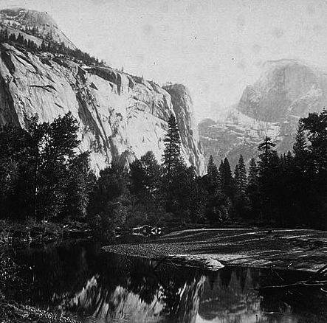
Digital Master Specifications
Color or Grayscale?
90
Notes:
Answer these questions:
Do you want to capture the texture?
The object as it is or as it might have looked?
Should you use grayscale for modern black and white prints or bw negatives or use color which is a much bigger file but can render color. An albumen print is monotone, but not neutral black it’s purplybrown.
Do not use lossy formate use RAW and TIFF open sources not proprietary - these will be easier to handle later and are more accessible to everyone.
LC does grayscale modern bw prints and all bw negs Smithsonia and Natural History does color
But is 3x th size to store and complexity of color more challenging

Slide 91
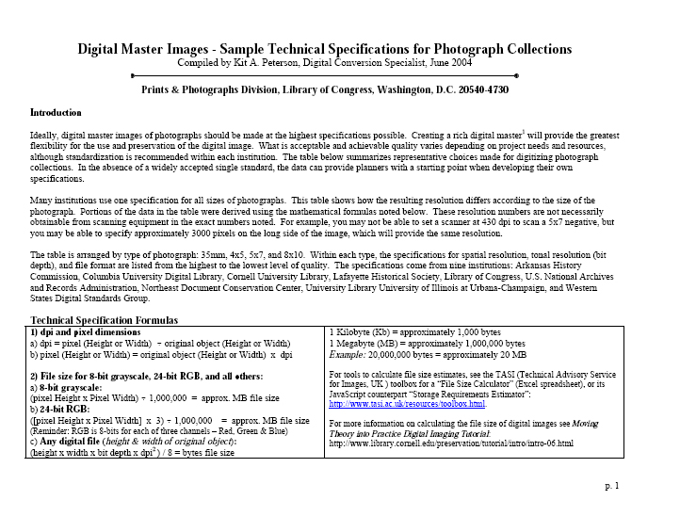
Digital Master Specifications
91
Notes:
Answer these questions:
Do you want to capture the texture?
The object as it is or as it might have looked?
Should you use grayscale for modern black and white prints or bw negatives or use color which is a much bigger file but can render color. An albumen print is monotone, but not neutral black it’s purplybrown.
Open source such as TIFF raw
Do not use lossy formate use RAW and TIFF open sources not proprietary - these will be easier to handle later and are more accessible to everyone.
LC does grayscale modern bw prints and all bw negs Smithsonia and Natural History does color
But is 3x th size to store and complexity of color more challenging

Slide 92
Derivative Images
Thumbnail
Reference images
92
Notes:
Analogous to copy prints
Thumbnail usually goes with text on a screen and very quick reference
Full screen - more detail.
Often in JPEG or GIF
JPEG – may use for use/purchase by staff and researchers
But it’s a lossy format (to help with storage and delivery)
Less so for printing not publication

Slide 93
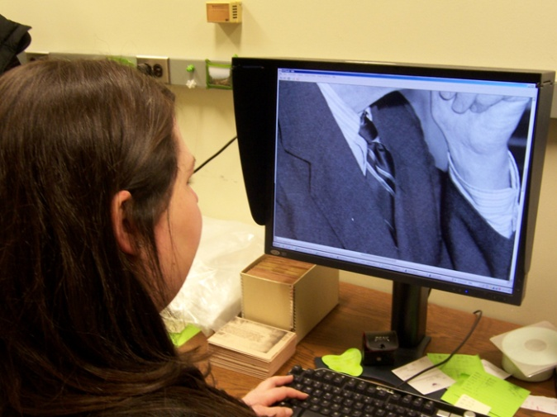
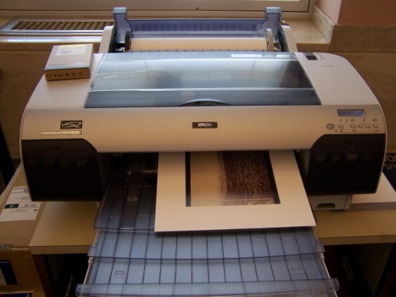
Equipment
Computers, software
Monitors
Printers
Scanners
93
Notes:
Buy the most you can afford at the time
Hard to recommend as equipment changes so quickly through time. Determine what you want to do then research what’s out there for our purposes.
Most scanners and cameras have built in software to make the image look better even before you work omit. Decide if you want this or DIY
Calibration of color image between scanner/monitor/printer
Use targets - color info same as a ruler helps to compare if using the same scale.

Slide 94
Quality Control & Quality Assurance
Initial investment means time & cost savings
Close, ongoing communication essential
Catch problems as they happen, not when project is completed
94
Notes:
You shouldn’t just hand over a project to a technician and expect it to be done to your standards unless you monitor the progress as it goes.
You may learn that some technical aspect needs changing

Slide 95
Quality Control
During set-up of project:
Check technical specifications
Evaluation & start-up tests
Establish Deliverables (small & large)
95
Notes:
Is a stae initial set up
Work closely with technicians to make sure your’ve getting what you want – coordination between equipment
And evaluate at strategic intervals
What will be products (deliverables)
Inventory or database
Delivery medium dc – magnetic tape
Metadata file headers such as archive name
Image naming conventions

Slide 96
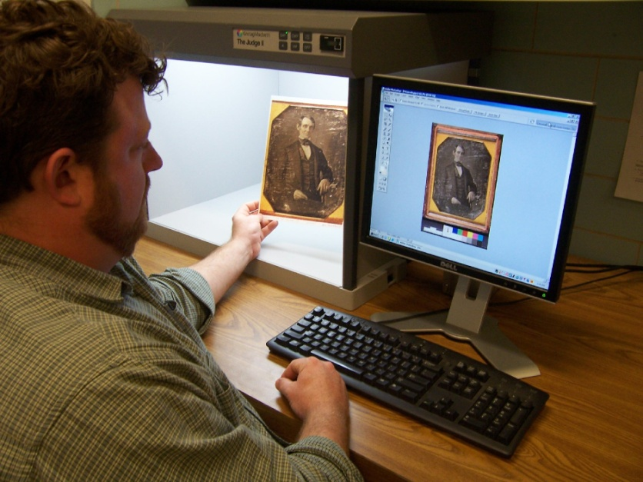
Quality Assurance
Once the project has gotten under way:
Ongoing technical review
Use of targets to aid this process
Ongoing subjective review by staff & users
96
Notes:
Check everything at first, then establish samplign rate make reqular schedule and stick to it
In each capture or at beginning of working session
Remember bad microfilm and bewarned
Then maybe 10%
Checklist, sampling procedures

Slide 97
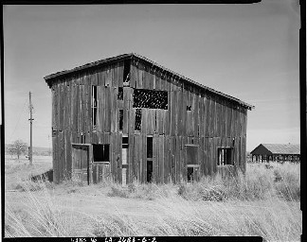
Managing and Preserving Digital Images
Metadata
Digital Repository
Preservation
Refreshing
Migration
Emulations
97
Notes:
Depends on whether its an investment worth protecting
Technical inforamtion as well as cataloguing
Track access store and preserve
Your creating a record collection
Sometimes it’s born digital
Where its kept and by whom – commercial services – shared with other instituions
Unlike photos leave alone digital rerquire active management cd to cd
REFRESHING – saving to a new medium CD to CD
MIGRATION – converting to new media 31/2 to CD or magnetic tape
EMULATION – creagint old processing systems to use old format data.
Resources for learning - formal training or looking at compartive projects published guidelines NEDCC IPPI best practices

Slide 98
Digital Photographs: Hard copies
Digital prints
Inkjet
Electrophotography (“laser,” also “photocopies”)
Other proprietary processes
Technology subject to rapid changes
Notes:
Ink on paper - use reputable companies with specifies inks and papers
Fading getting better
INKJET mide 80-s to now – are pigmented printers that are producing good results (wilhelm associates for data)
Electrophotogrpahy early 80’s to now - if black carbon on goo paper then v permanent
Wax sublimation dye diffusion transfer
Laser chomogenic dye sub?
Changing technology – have to keep up with it to be an informed consumer.

Slide 99
Module 8: Public service & outreach
Notes:
[Members of the Monaghan Men’s Irish Dancing Class and their partners], LOT 10009, c1905 May 27, c by S.A. Sigerist, cph3b22745.
Quote from PACM draft, p. 268
“Reference and outreach are the mating dance between the repository and the researchers. The key to success is clear communication.”

Slide 100
Basic reference
Researchers
Training & orientation
Research room
Services
Glossary: A service to aid patrons in locating materials relevant to their interests
Notes:
Interior of café in Philadelphia Bourse, LOT 4923, c1896 Sept. 17 by J. Wesley Allison, cph3b03098
Deleted Making a sale. Seed store, Marshalltown, Iowa, LC-USF34-060759-D, 1940 Apr., John Vachon, FSA/OWI, fsa8c17264
(compare to buying groceries/making a transaction with a customer)
Researchers: compare to customers seeking service/product
Training: employees and customers (goal to be self-sufficient); for example, teach how to use descriptive tools
Research room: management of facility, procedures and policies
Reference activities: service provided and managing risks: emergency, theft, vandalism, protect property, security in a public place

Slide 101
Researchers
Amateurs & hobbyists
Professionals
Academics
Contractors
Notes:
When it comes to congestion in the public schools, … LOT 12355-2, (Petworth? School, WDC), [1920], National Photo Company Collection, cph3c08288, LC P&P.
Ask for participation here. Types of typical researchers.
Amateurs include family and local history folks, lighthouse buffs, photo collectors, railroad buffs, and reenactors.
Contractors include picture researchers and contract legal researchers.
Professionals include folks seeking illustrations for an exhibition, film, publication or other work including artists and designers, curators, educators, exhibition preparators, filmmakers, historic preservationists, journalists, interpreters, lawyers, and publishers.
Scholars include anthropologists and archeologists, curators, historians, social scientists and scientists.
EX: NARA posts their Customer Service Plan on their website defining both their customers and services.

Slide 102
Training & orientation
For Staff, Volunteers and Visitors
Building orientation
Services available
Explain procedures
Provide documentation
Notes:
French journalists visit the National Gallery of Art, Washington, D.C., March 4, 1945. Left to right: Pierre Denoyer; Rene Batigne, Curator of the French Section at the Gallery who guided the guests on their tour; M. Jacques Rabut, Head of the French Construction Mission in Washington; and Mme. Andree Viollis, LC-USW3-057408-C, 1945 Mar., J. Sherrel Lakey, FSA-OWI, fsa8d37760, LC P&P The first place all researchers go is the bathroom. NARA in Kansas City has tried to decorate the rest rooms with photographs and furnishings that help set the tone for the visit. Other important initial questions you want to be able to answer is good local restaurants/hotels and other photo repositories in the area.
If this is the researchers first visit to an archives you may want to encourage them to do their basic library research first, so they are not coming to you for an overview on the Civil War, or you can keep a small linked library that you refer staff to in or near the research room. For new researchers, a basic archival orientation that includes not only handling instructions, but what finding aid is, how archives work generally, why we maintain photographs in their original order, why they may not correct captions or finding aids on the spot, reorganize materials they believe are out-of-order, remove images they do not approve of, or otherwise impose their views or corrections on the collections at hand. Why they can not remove photographs as they would circulating books from a library. Some may wish to “borrow” images without your knowledge so they don’t have to pay for copies. You may have to explain that an archives is more like a museum of unique works than it is like a public library. Removing the item, means losing the work, while the repository is happy to make copies for anyone.
Goal is to make researchers as self-sufficient as possible. Clarify services provided and timing/clarify user needs and timing. The key to making the researcher happy is to let them know as fast as possible what you have to offer them in the way of services and appropriate holding to their needs. They need to know how long each step will take and what they must do. Prepare checklists of popular images
Think about core users (audience, mission, service levels); equal access vs. varying levels of service (public/private). Equal/open access to all. Services include: copying, citation checking, loans for exhibits or publications, permission or copyright research, level of reference support, level of research provided.
PACM, pp. 296-297, Appendix 9-B: Sample Procedures to Assist Researchers.
DELETED: Researcher registration: Registration form, Copy & use agreements, Reproduction info, Picture ID, Locker for belongings, Handling instructions, Requesting access
Check pix ID when you register researchers: Check and record the researcher’s picture IDs—keep in mind it is not difficult to get a fake ID, so watch for discrepancies in the researcher’s story and id
Place their personal belongings in lockers
Make the researcher read and sign the agreements regarding registration, handling/ Copying/usage policy. Save agreements.
Make the researcher sign any request forms when materials are received
Explain the archival services, including: Assistive services (e.g., magnifiers, software), Contract researcher services; Copy services; Guidance from staff, Special equipment available (e.g., dust masks, gloves, light tables, magnifying loupes, microfilm readers, public access computers)
EXAMPLE: LC P&P website provides information for researchers about registration and use of the collections; explains when appointments are necessary or when it is necessary to request material ahead because it is stored off-site.
Reminder: Orientation as welcome, not direction!
Photo Reference slide DELETED: Visual literacy; Reproductions ; Restrictions; Cold/off-site storage ; Handling ;Health & safety ;Theft
No. 28-The Kodak Girl, SSF-Photographers, LC-USZ62-70574, c1909 Feb. 17, cph3b17968, LC P&P.
How to explain to researchers special requirements for working with photos. Need to be able to communicate all the information we’ve been discussing to those without your experience.
Review of concepts from Reading Photos module: Many researchers/staff can’t “read” photos or understand how their meanings can change (photo manipulation/photos can ‘lie’); conversion of words used in descriptive tools to visual image.
Handling includes instruction in using fragile materials, variety of formats and sizes, understanding relationship of multiple generations (using copies instead of originals, negs. without prints, digital surrogates).
Health & safety risks: film negatives
Cold storage acclimatization
Unfortunately until repositories begin to retrain or hire more visually literate archivists and librarians, photographic reference effectively will remain a challenge.

Slide 103
Research room
Uncluttered
Clean
Easy to monitor
Appropriately equipped
Furniture
Lighting
Special tools
Handouts
Forms
Signs
Notes:
Cashier’s desk in department store. San Augustine, Texas, 1939 Apr., Russell Lee, fsa8b21605, LC P&P, FSA-OWI
Room Design: Welcoming/attractive, “clean”— uncluttered, easy to monitor with clear sight lines (no hidden areas or obstructed views), easy to use due to clear signage and easy to locate elements, such as copy machines.
Space/Equipment: Lockers immediately outside for holding belongings; posted signage and registration procedures. Signage that covers: warnings of any health and safety issues; prohibitions on carrying weapons, prohibitions on food, drink, and smoking; warning about USA Patriot Act use of research records; reminder that researcher belongings will be checked; Reference desk with trained staff; Space to acquire and fill out researcher registration form; Security monitoring (CCTV, mirrors, sight lines); A stable environment; Comfortable furniture, preferably not new oak (oak is most acidic of all woods/outgassing problems/must be sealed unless antique), including: Tables and chairs, Reference book shelving.It needs to be clear if the user may bring in a scanner, digital camera, personal copy machine or if the user can set up and use a facility copy stands, copy machine, or camera. Adequate lighting placed so it doesn’t interfere with carts or holdings.
EXAMPLE: NARA has a web page that provides general information for visitors about the use of photographs and graphic materials at their repository. Information for researchers, use of copy equipment, and other policies.
To be ADA compliant, keep the research room: Doors 32+ inches wide; Aisles 36+ inches wide; On the ground floor or accessible via an elevator or ramps; All handles, buttons, and facilities no higher than 40 inches from floor; Reception and reference desks low
This Website can be useful in identifying assistive technologies for use in the research room.
Websites: CAP (Computer/Electronic Accomodations Program) has special screens for visually impaired.
ADA home page (ADA Standards for Accessible Design) and PACM p. 278: How to Create an Americans with Disabilities Act Compliant Research Room (www.usdoj.gov/crt/ada/adahom1.htm)
DELETED: Equipment & Tools: Book cradles, Book trucks, Lamps, Light tables, Microfilm reader printers, Public access computers, Gloves, Magnifying glasses, Viewing loupes, Pencils, Handouts, Reference tools, Literature rack, Reference tools—books, brochures, and pathfinders, Researcher registration forms, including rules for researchers, Repository produced, permission to publish information sheet
SEE PACM, p. 276

Slide 104
Reference services
Empathetic listener
Visually literate
Familiar with holdings
Capable of refining queries
Ability to turn words into pictures
Notes:
Emotional intelligence / Empathetic listening / Refining queries / Familiar with holdings / Visual literacy / Strategizing / Follow-up
Rephrase, discuss & refine query: Actively rephrase and repeat what you hear, “Let me see if I understand what you want. You would like to see views of coal mining operations between 1900-1975 in the Erie Pennsylvania region, particularly those that show minorities and working conditions including mining disasters. You are also interested in the living conditions of miners and their families, particularly in Erie, Pennsylvania. You would particularly like domestic interiors with mining families and funerals of miners. You need to find the images this week and order copies for delivery no later than two months from now. You plan on using the images in a book and an exhibit so you want copyright free images if possible with little in the way of permission requirements necessary. Is this right?
President Lyndon Johnson with Senator Richard Russell at the White House, December 7, 1963, Washington D.C., Print. (W98-30).Courtesy of the Lyndon Baines Johnson Presidential Library at the National Archives and Records Administration.
President Gerald Ford and foreign correspondents preparing for a television interview at the White House, Washington, D.C.], 1975 May 23, Marion S. Trikosko, U.S. News & World Report Magazine Photograph Collection, LC P&P, ppmsca08476
DELETED: REFERENCE INTERVIEW Be welcoming, but realistic about what can be done: · Subject matter and discipline (scientific images), including genre (cityscape, landscape)-- Provenance, and purpose----Time period, temporality, and genre (e,g, Victorian winter cityscapes)-- Visual characteristics (e.g., color, composition, image orientation, polarity, focus, presentation format [e,g, framed], format [e.g., stereograph], style, and vantage point [e.g., aerial])--Usage history
Other reference strategies: Composition; Presentation; Context; Contrast; Generation; Genre; Format
Specific application to photos here, enhancements. When trying to narrow a search, also consider the following photographic features:
captions (e.g., availability, completeness, language)--composition (e.g., layout of the visual elements)--contextual information (e.g., signatures, studio markings)--contrast (e.g., the degree of difference between the darkest and lightest areas of an image), as designers may care about this--formats (e.g., cartes de visite or stereographs) ; generation (e.g., original or reproduction) ; image genres (e.g., abstract, cityscape, landscape, or portrait)--image orientation/presentation (e.g., horizontal or vertical); image polarity (e.g., positive or negative); image resolution (e.g., level of sharpness and detail, depth of field) ; image purpose (e.g., who the material was created for, why, and how); style (e.g., amateur or commercial, straight photographs or Pictorialist soft focus images)--image temporality (e.g., era, season, or time of day) such as winter cityscapes at dawn); special presentations (e.g., cases, frames, mats) --provenance (e.g., who acquired, created, or used the photographs in the past)
Discuss the researcher’s goals, intended products, and timeframes. Ask about the depth, length, nature, and purpose of the researcher’s work.
Negatives are not used for reference, but instead are kept for preservation and duplications purposes. However, if no prints or transparencies exist and digital copies can’t be readily made, some repositories will make an exception for certain significant usages.

Slide 105
Finding & requesting photos
Use descriptive tools
Online
Catalogs
Finding aids
Reference sources
Find most relevant photos
Complete call slips
Notes:
Wellington, Kansas. Atchinson, Topeka and Santa Fe engineer going off to work stops in the locker room for his tool kit, LC-USW3-020103-D, 1943 Mar., Jack Delano, OWI-FSA, LC P&P, fsa8d15270.
Biggest bang for the buck. Self-service options. Describe search results positively, even if modest
Analyze and translate the query into collections: Show the researcher how to use finding aids; help the researcher rank collections by their relevance to his query given the amount of time he has;
Call slips: explain how to fill out and sign call slips to request collections. Pull slips, also known as call slips, researcher request slips, or refile slips, should have a place for researchers to sign when they receive the collection and for staff to sign when the collection has been checked for completeness and gone back on the shelf. This is a very powerful security took and can be helpful when trying to prove who may have walked with a vanished photograph. File multiple copies of the pull slips by the last name of the researcher, the date of use, and the collection if possible to facilitate later searching.
Also, reiterate information on handling, viewing & use

Slide 106
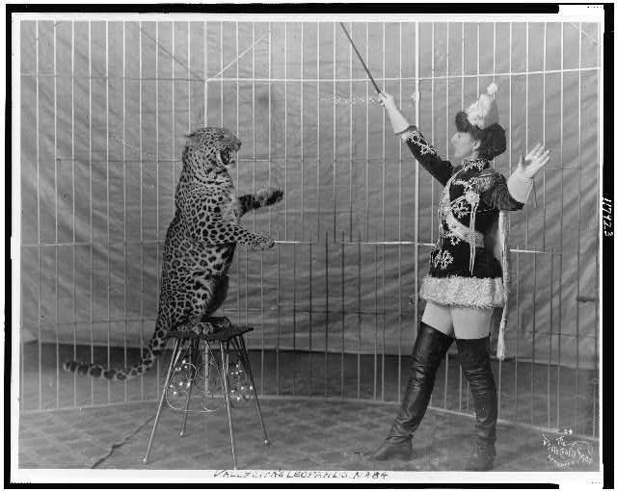
Viewing & use
Rules & behavior
Access
Pulling & paging
Monitor handling
Appointments
Use
Photocopies
Citations
Reproductions
Notes:
Vallecita’s leopards, SSF-Circus & shows—Animal acts—1906, c1906 from the Photo Crafts Shop of Denver, cph3c17923.
Train Staff and Researchers: Rules & behavior; Handling; Access & use; Copying; Citing references; Special storage; Pulling & refiling
Not much different than basic archival procedures, esp. in terms of behavioral requirements (registration, no cell phone); Need to do basic publications research elsewhere; Finding aids, Rules for personal belongings and equipment, Schedule information, when pulling occurs and remote storage issues
Some differences: caption and credit line policy, Requirement to use copies for research, Restrictions, Handling requirements, Rules for personal equipment for copying,
Explain why policies are in place, for example, often researchers and staff do not want to be bothered signing request slips when they receive and return items. If this is not done and photographs are discovered to be missing from materials that researchers have used, it is that much harder to prove who had the opportunity to steal an image and when it was last used and seen in repository for purposes of theft recovery through the courts.
Special storage = off-site or cold
Your reference room manual and training should cover all of these issues and more. For example in security procedures some research room manuals explain in great detail how personal scanners may be brought into a research room, what types of scanners are acceptable, how scanning must be done, what may not be scanned, and how scanners are to be registered upon arrival, cleaned during operation, and checked upon departure. Having a reference manual makes it clear what is and is not appropriate, taking some of the stress out of the reference interaction as the decisions have already been thought through and must now be followed.
On demand handling training via the Web or in person, (indiv or group sessions), videotape, written guidelines
PACM, p. 278: How to Teach Safe Handling of Photographs in the Research Room
DELETED: Handling, viewing & use: Procedures for proper pulling & paging, Handling instruction (special, oversize, fragile), Procedures for photocopying, Reproduction information, Restrictions on use & access (supervise photocopying, restrictions on use and access)
Tactfully handle photographic mishandling. Know what to do when situations arise.; Monitor the research room ; Manage restrictions while supervising copying; Signed copyright and use agreements.; Request copies and cite collections; Obtain caption approval (if necessary); Obtain permission to publish (if necessary); One book truck at a time; one image from one folder from one box at a time; policy for number of boxes available from one book truck at one time; frequency allowed for requesting another cart; Copy request procedure; citation and caption requirements, permission to publish
Staff check for restrictions (use and access) and preservation warnings before pulling collections. If there is an access restriction, do not pull it unless the materials have been screened and made safe for use or special permission has been obtained and shown by the researcher from the equity holders.
Staff load boxed collections onto book carts
Staff store book carts in secure staging areas
Special handling requirements for oversize, fragile or damaged materials. If oversized, use an adequately sized cart.
EXAMPLE: There are many ways to get repros. LC P&P website provides a vendor list that includes option of ordering duplication in-house as well as a listing of other outside vendors that can supply reproductions of select collection holdings (zazzle.com for facsimilies and Found Art—for Curtis images)
Dialog with Laura, return to Handling…
DELETED: Brooklyn Public Library (Intersoll Memorial), Prospect Park Plaza, Brooklyn. Children’s Room, from librarians’ desk, LC-G612-39216-B, 1941 Feb. 1, Gottscho-Schleisner, Inc., gsc5a16989, LC P&P.
If there is a usage restriction, please let the researchers know up front.
A lack of effective secure staging areas is one of the great weaknesses in many archival buildings.

Slide 107
Exit procedure
Refile ASAP
Capture usage metrics
Get researcher feedback
Spot-check photos
Check personal belongings
Notes:
[Interior of Piggly Wiggly store, Tenn., showing entrance turnstile with small wicker shopping baskets, and check-out counter; 1st self-service grocery store in U.S.], LOT 9998, LC-USZ62-55462, c1917, photo by Clifford H. Poland copyrighted by Clarence Saunders, LC P&P, cph3b03349.
Capture usage metrics by retaining request slips and registration forms.
Spot check to look for missing, mishandled or misfiled items, sign for return and refile asap.
Ask if problems.
Emergency preparedness: Have an emergency evacuation procedure, practice drills, stay safe without security breakdown, bring sign-in log, know evacuation route, watch what people take.
Document incidents of security breakdowns, theft and vandalism.
Handout: Security/Theft.

Slide 108
Outreach goals
Visibility
Support
Increase users
Find new audiences
Develop partners
Enhance capacity to serve
Notes:
[Man holding large camera photographing a cataclysmic event, possibly a volcano erupting], SSF-Photography-Photographers, LC-USZ62-115987, c1908, Underwood & Underwood, cph3c15987, LCP&P.
Researcher visits to archives now down nationwide by as much as 20% a year. Searchers using web. Outreach attracts both general visitors and researchers.
Outreach to Attract new interest (donors, funding sources, partnerships & stakeholders)Gather and organize project planning information, share it with funding sources. Planning data becomes an essential tool for project management and for press releases as the project proceeds. Once the event or activity is completed, project documentation should be prepared for placement in the repository’s own archives or records center, depending upon the repository record schedule. Look for an option that will help distinguish your repository from other local cultural organizations. Determine the type of program that will best serve not only the repository and the general community, but the repository’s major stakeholders. Look for partnerships, collaborations, and cooperative efforts that will support your repository using shared resources. Raise the profile of the archives in your community. Look for potential opportunities that will help serve the archives’ goals. Deciding what kind of outreach to do may be as simple as looking at your local opportunities and needs.
DELETED: Attracting Researchers: Maps, Signage, Brochures, Reference sources, Talk to colleagues, Basic phone & web info, Guides, Low-cost parking
[Crowd on the boardwalk, Atlantic City, New Jersey], SSF-Crowds, LC-USZ62-98786, c1910, George A. McKeague Co, cph3b44864, LC P&P. Staff needs to be friendly and welcoming (customer relations skills) Follow the basic public relations steps described later in this presentation. Too often photographic repositories are humble and self-effacing organizations that make no attempt to reach out to the larger communities that might find them useful. Know your repository’s core audience and communities of users. Reach out to them. Make certain they know who you are, what you have, and how you might serve them. Maps; Signage (streets and public transport); Brochures; Reference books; Promote organization to information professionals; Basic phone and web info (photo archive has different hours than library); Guide; Website registered with search engines (moved to web outreach page); Low-cost parking

Slide 109
Outreach projects
Format
Genre
Photographer
Provenance
Event
Time period
Place
Theme
Notes:
Choosing outreach projects:
A format, genre or viewpoint
A photographer, school, studio, collection or group
An event, place or era
A theme or topic
one viewpoint, genre, or format, such as aerial photographs or Birds eye perspective. A format such as stereographs or cartes de visite,
A genre such as cityscapes, harbor scenes, or portraits.
Images from a single photographer, collection, or group, such as a particular studio such as Studio 323 in New York, a school of photographers such as the Pictorialists or the a group of amateurs on a particular event, such as San Francisco Earthquake, The Chicago Fire, The American Bicentennial in New York
work documenting a particular place and time, such as 19th century sailing ships in Boston Harbor, Round-up in 19th century Fort Worth
particular themes, such as: Immigration and naturalization in the American West, Farming during the Great Depression, American Interior Design during the 19th century, Childhood in Philadelphia in the 1920s.
Examples from deleted slide examples (screen shots): Getty Research Institute’s 19th century photography of ancient greece or Brandeis University’s online exhibit of Carl Van Vechten’s African-American portrait photographs
Lewis Carroll Centenary at Harry Ransom Center, UT@Austin
http://www.hrc.utexas.edu/exhibitions/online/carroll/
http://www.archivists.org/archivesmonth/AAM2008/2008_ilarchivesmonthposter.pdf
http://www.archivesmonth.org/2008-poster-large.pdf

Slide 110
Web-based outreach
Photos online
Digital image libraries
Descriptions only
Repros for sale
Education
Distance learning
Conferences
Publications
Web exhibits
Notes:
[Man and woman in middle of spider web to illustrate the popular song, "The Spider and the Fly"], LOT 10243, c1901 by J.D. Cress, cph3b20726, LC P&P.
Incorporate the web into everything: Cooperative heritage projects, Catalogs & databases, Collections or individual images on-line, which can feature an on-line public access catalog (OPAC) or on-line finding aids; samplers or greatest hits of “born-digital” or scanned archival photographic holdings and captions on-line; entire digitized collections of photographs on-line with captions and context; and cooperative heritage projects featuring historical photographs
Example: The King County, Seattle, Washington, area’s database holds the photograph collections from twelve county repositories including archives, heritage centers, historical societies, libraries, and museums, in a single, comprehensive, searchable database.
Distance learning courses provide researchers with the convenience of learning about a new topic via their home or office computers; On-line conference proceeding and streaming video or still images of virtual conferences; On-line exhibits provide virtual galleries with digital objects and metadata designed to explore a topic or theme or illustrate a story that the user can navigate like a real space, or linked series of photographs with metadata; On-line publications, such as e-books or e-zines; outreach features contemporary or historical photographs as content. Photographs add color, dimension, human interest, and texture to these Web sites, attracting and holding viewers’ interest.
EX: NARA http://www.archives.gov/locations/ web site redirects to specific regional calendars with information about exhibits, broadcasts and events.

Slide 111
Fundraising
Grants
Private foundations
Direct mail campaigns
Corporate giving
Gifts
Bequests
Notes:
[Woman selling produce in market, Hungary], LOT 11463-2, LC-USZ62-113787, [1923], Frank and Frances Carpenter Collection, LC P&P, cph3c13787.
Make preliminary contact and connections (network).
Manage project and funds, report back to funding source and publicize accomplishments.
Fundraising includes any efforts you make to get the needed or desired resources for photo care, programs and outreach. You can solicit money in several ways: corporate giving, direct mail campaigns, foundation funding applications, and traditional programmatic grant applications (e.g., Institute for Museum and Library Services, National Historical Publications and Records Commission, and National Endowment for the Humanities). Photographs take up little of the proposal’s precious word or space allotment. Use photographs as section dividers, cover illustrations, and samples to help make your proposal stand out.
PACM, pp. 468-470, Funding Sources
Foundation Center: http://foundationcenter.org/ Can search by name/location (region)

Slide 112
Outreach
Glossary: The process of identifying and providing services to constituencies with needs relevant to the repository's mission, especially underserved groups, and tailoring services to meet those needs.
Collection-based outreach
Publications
Events
Public & human relations
Notes:
Glossary: n. ~ The process of identifying and providing services to constituencies with needs relevant to the repository's mission, especially underserved groups, and tailoring services to meet those needs.
[Boxer Tut Jackson clothed in boxing trunks, full-length portrait, standing, facing front, with his arms extended out from his sides, showing his reach], BIOG FILE – Jackson, Tut, LC-USZ62-105319, c1922, Ace News Features, cph3c05319, LCP&P.
DELETED: A Marine Corps glider being towed by a power plane from Page Field, at Parris Island, S.C., 1942 May, Alfred T. Palmer, FSA-OWI, LC P&P, fsac1a35168.
Increase visibility: find potential contributors of photos
Sometimes, the last thing photo collections managers have time to think about is outreach programs, but let’s pretend we have the time and resources to engage in this.
Web-based outreach; Fundraising; Collections development campaigns; Conferences/symposia; Cultural tourism listings; Educational programs; Exhibitions; External publications listings; Marketing; Partnerships; Partnership product development; Publications; Publicity; Special events; Support groups
Conduct interviews; Contact photographers via professional groups; Create a direct mail or email campaign; List photographs explicitly in records schedules; Meet donors face-to-face at community events and exhibit openings (research donors in advance: credit lines, publications and citations); look for donors in targeted departments and programs; Hold events: Offer presentations, tours & open houses; Go on public service programs on the radio and tv and with local journalists and Conduct interviews; Contact photographers via professional groups, create a direct mail and email donations campaign, list photographs explicitly in records schedules so that staff know where they are likely to occur (e.g., pr photos, etc); meet donors face-to-face at community events and exhibit openings; offer presentations on your photos and needs in the community; offer tours and open houses; Post descriptions of bequests on your website and in your annual report; Print bookmarks and brochures featuring your photos; Provide naming opportunities; Raise funds to purchase indirectly via web auctions; Research donors via credit lines, publications, and citation indices; Visit departments and programs that could become donors; Write articles and develop Websites
When Resources Are Limited, PACM, p. 411; Appendix 10-D: Sample Licensing Agreement (with credit), PACM, pp. 338-339.

Slide 113
Types of Outreach
Collection-based outreach
Collections development campaigns
Exhibitions
Product development
Publications
Internal publications
External publications
Cultural tourism listings
Events
Conferences & symposia
Educational programs
Special events
Public & human relations
Marketing programs
Partnerships
Publicity activities
Support groups

Slide 114
Outreach risks
Too much response (users & donors)
Divert resources
Damage reputation
Damage photos
Lawsuits
Notes:
Washington, D.C. Checking over purchases while waiting in line to pay the cashier…, 1942 June-July, Marjory Collins, FSA-OWI, LC P&P, fsa8c36424
Attracting more users and donors than the archives can effectively handle
Diverting all of the archival resources to a noncore activity, thus slowing down archival accessioning, appraisal, arrangement, description, and reference work
Causing lawsuits due to improper use of materials with copyright, privacy, or other statutory protections
Offending a community or group of donors, sponsors, or providers by an inappropriate or impolitic focus, emphasis, or interpretation (damaging relations/reputation)
Providing inaccurate information that may damage the repository’s reputation (damaging reputation)
Damaging original photographs due to poor handling or overuse (damaging holdings)
Careful management, planning, and review should minimize the likelihood of these problems, while maximizing the visibility and increasing the customers for your collections and services. Consult with your stakeholders. Involve your community in the work. Plan ahead. Give yourself enough time and acquire enough resources to completely plan and carry out your outreach project in a fully professional manner.

Slide 115
Evaluating programs
Audience feed-back forms
Mail & email response forms
Questionnaires
Outcome based evaluation
User group surveys
Notes:
Winner of the plant suggestion award. David Danzig, an employee of American Locomotive Company, Schenectady, New York, drops her suggestion for improving efficiency in the plant’s suggestion box, 1943 Jan. by Howard R. Hollem, FSA-OWI, LC P&P, fsa8b05693
Capturing audience feedback information ensures that the repository will learn from the experience so that future efforts can be more polished and effective.
EXAMPLE: NARA website includes page on Customer Service and area where you can elect to respond to surveys or give feedback/comments or review annual reports, performance and accountability records.
DELETED: Continuing education slide: Conferences; Professional organizations; Universities; Distance learning; NARA’s Archival Training Calendar; BACE
Archival Training Calendar Continuing Education Opportunities: Courtesy of the NARA Office of Regional Records Services
Other Listings
Funding Sources - Grants, Scholarships, and Fellowships
Regularly Occurring Courses or Multiple Listings by One Organization
Virtual or Distance Learning Programs
Electronic Mailing Lists (Listservs) for Archivists
Other Training Calendars
United States: University-based Training Programs
English University-Based Courses

Slide 116
Thank You!
Laura Downey Staneff
ldstaneff@ionsky.com
Marcy Flynn
silverim@mindspring.com
Notes:
[Cissy Fitzgerald, full length, standing, curtsying, facing right; coquettishly holding up skirts to show fancy slips], BIOG FILE, c1895 Mar. 11 by W.M. Morrison, cph3b05414, LC P&P
Plug upcoming annual meeting in DC.
Wrap-up:
Questions & Comments
Evaluation forms
Certificates

